Slide 1
Building an Effective Peer Support Program: A Proven Volunteer Model Disability Liberation Theory
September 24, 2014
2:45 p.m. – 3:15 p.m.
Presenter:
Amina Kruck
1

Slide 2
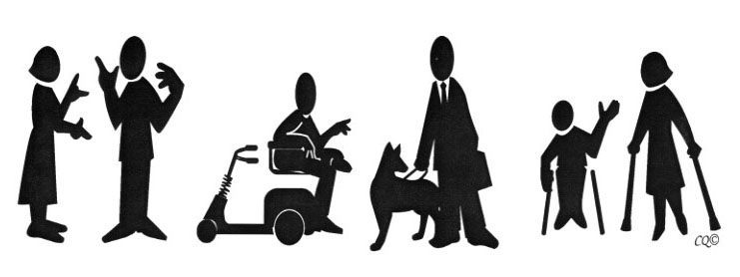
Liberation Policy for People with Disabilities
Reality about who we are: Good, lovable, valuable, creative, intelligent, cooperative, attractive, strong, powerful.

Slide 3
What is Oppression?
Economic/political system where vast majority of people work to produce wealth for a small minority who own and control the wealth.
It causes disability
It stereotypes people with disabilities as less or non-productive, and by its own terms dis-values and further dis-ables us.

Slide 4
How Oppression Works
Every oppression relies on the psychological trick of separating one group from another by virtue of some real or imagined difference—then using the difference for an excuse for mistreatment.
It is about power!

Slide 5
A Different View of Disability
Who are we talking about? Examples of who is considered “disabled”
There is no “normal;” everyone is different physically and mentally.
Is disability a tragedy, a circumstance, a change…How do we view it?

Slide 6
Independent Living Vs. Rehabilitation or Medical Paradigms
REHABILITATION PARADIGM - PROBLEM | INDEPENDENT LIVING PARADIGM - PROBLEM
Physical or mental impairment; lack of vocational skill | Dependence upon professionals and others; public attitudes
In the individual | In the environment; in the medical / rehabilitation model and process
Professional intervention; treatment | Barrier removal; advocacy; self-help; consumer control

Slide 7
Independent Living & Rehabilitation/ Medical Paradigms, cont’d.
REHABILITATION PARADIGM | INDEPENDENT LIVING PARADIGM
Individual with a disability is a "patient" or "client" | Individual with a disability is a "consumer" of services or simply a "citizen"
Professional is the expert | "Consumer“ is the expert. Need true partnership.
Maximum self-care; gainful employment | Independence through control over acceptable options for daily living in an integrated, community-based setting

Slide 8
What is YOUR Earliest Memory?
Break up into pairs
Determine who will be A and who will be B
Trade time in a Think and Listen exercise:
What is your earliest memory in any way at all related to a person’s physical or mental difference?

Slide 9
Results of Oppression
Negative Stereotyping
Discrimination
Segregation
Institutionalization
Inadequate Incomes
Economic Exploitation
Environmental Barriers to Mobility
Control of our Lives by Others
Internalized Oppression

Slide 10
Ouch!

Slide 11
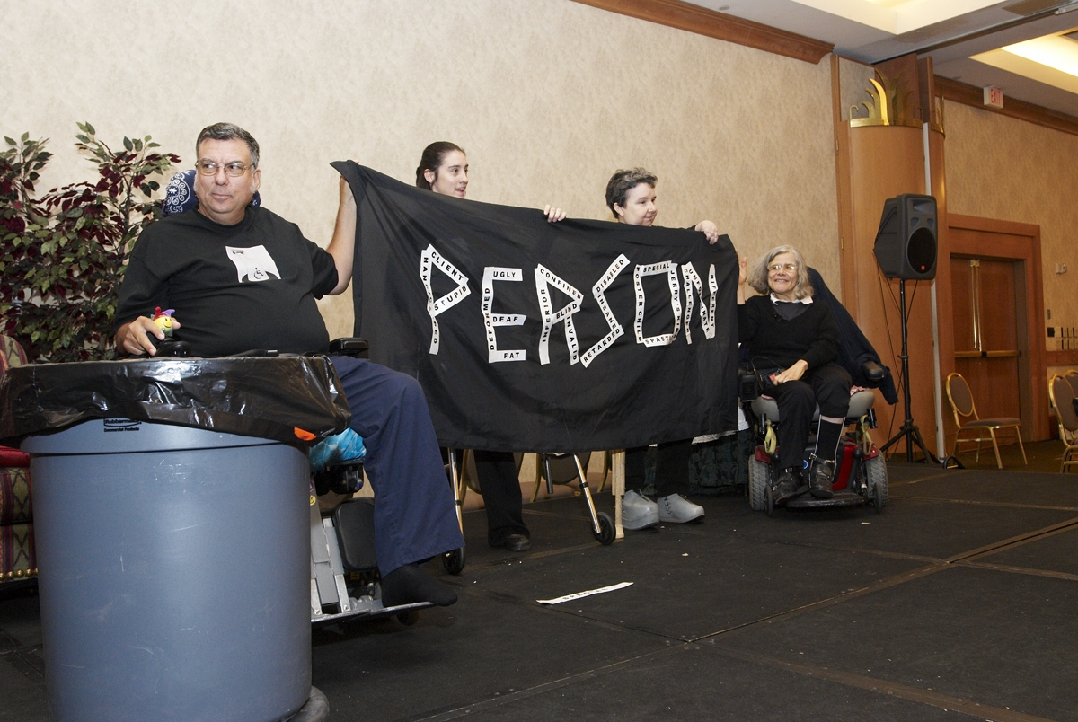
Creative Responses

Slide 12
Results of Oppression
Discrimination
Segregation
Institutionalization
Inadequate incomes – Poverty!
PWD 16-64: only 37% were employed (2005) that is 14M +
For 65+, 40.5% have 1 or more disabilities.
PWD 5yrs or over: 21% are below the poverty level (8M) compared to 11% people with no disability. (2005)

Slide 13
Results of Oppression, cont’d.
Economic Exploitation – sheltered workshops, low pay for care givers
Who makes money off as a result of a person having a disability?
Environmental Barriers to Mobility

Slide 14
Results of Oppression, cont’d. 2
Control of our Lives by Others
Limited or no choice
Dependency because of poor Independent Living Skills
Low expectations – don’t get asked or invited (opinion, desires, participation)

Slide 15
Results of Oppression, cont’d. 3
Internalized Oppression – we believe the negative stereotypes about ourselves and do not learn self-determination and self advocacy skills
Lack of political awareness
Less likely to vote
Less likely to run for office
More organizations for PWD than of PWD

Slide 16
Results of Internalized Oppression
Low expectations for ourselves
We have low self-esteem/ poor confidence
Poor self advocacy ideas
Isolation and feeling left out
We don’t show up!
Diverseness among ourselves
Denial of our disabilities and others
Blaming the disability for everything that is wrong

Slide 17
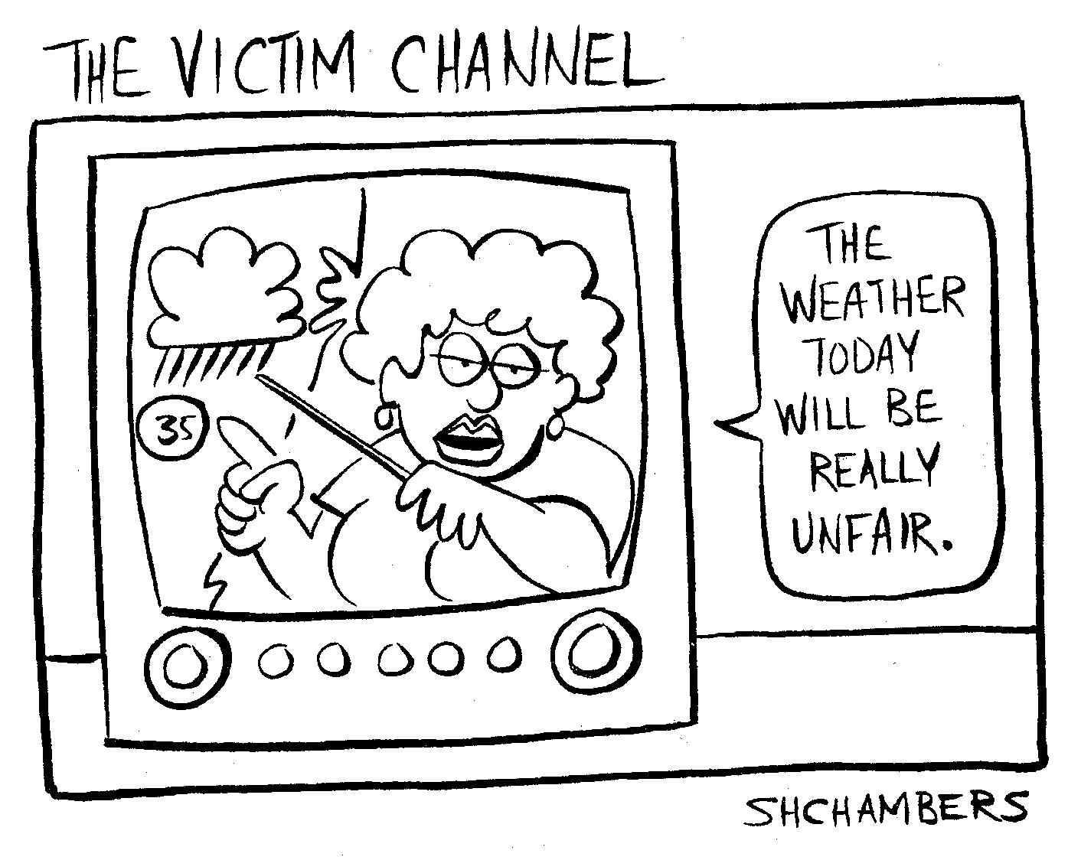
Compulsive Misery

Slide 18
More on Internalized Oppression
Compulsive cheerfulness or Compulsive misery
Feeling unattractive
Feeling unlovable
Feeling we have no rights and do now know our rights
Lack of social skills
Youth and employment—IEPs
Isolation from our allies

Slide 19
Internalized Oppression
Owning negative stereotypes as truth
For ourselves
For others with disabilities
We need our internalized oppression interrupted!
Encouragement to act outside the stereotypes – Be Bold!

Slide 21
Liberation is an Action Word!
Remember the truth about who we are and remind each other.
Knowing your legal rights and speaking up about them.
Show up
Get involved in things that matter to you
Don’t do it alone—get company!

Slide 22
Liberation is an Action Word! cont’d.
Learn the rules of programs you need or have services from
Make your own choices
Get to know other people with disabilities
Closeness - respectful physical and emotional
Awareness - Being able to ID oppression driven thinking and behavior

Slide 23
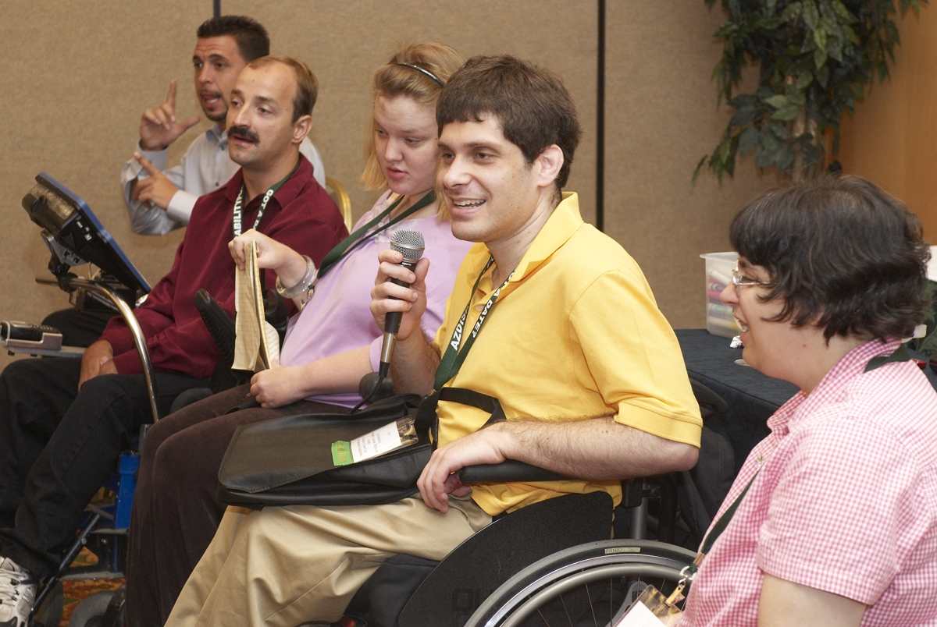
Learn Self-Advocacy Skills
How to speak up for your needs.

Slide 24
What We Need from Non-Disabled Allies— Teachers, Friends and Family
Explore their own feelings about their bodies, feeling different in any way, experiences with illness or others with disabilities.
Relaxed light listening. Remember feelings are not the hurt but the healing of the hurt.
Interrupt our internalized oppression – remind us of our truth.

Slide 25
What We Need from Non-Disabled Allies
Support our goals, ideas and dreams
Safe touch with permission and awareness. Have high expectations for us
Speak up about discrimination and inaccessibility

Slide 26
For more information
Contact:
Amina Kruck – aminak@abil.org

Slide 27
CIL-NET Attribution
Support for development of this training was provided by the U.S. Department of Education, Rehabilitation Services Administration under grant number H132B120001. No official endorsement of the Department of Education should be inferred. Permission is granted for duplication of any portion of this PowerPoint presentation, providing that the following credit is given to the project: Developed as part of the CIL-NET, a project of the IL-NET, an ILRU/NCIL/APRIL National Training and Technical Assistance Program.

