Slide 1
Financial Management: Workshop for CILs…Regulations and Beyond Baltimore, Maryland May 25-27, 2016
Presenters:
John Heveron, Jr. CPA
Heveron & Company, CPAs
Paula McElwee
IL-NET
Steven Spillan, Esq.
Brustein & Manasevit, PLLC
1

Slide 2
Lobbying― What is Permitted and Prohibited

Slide 3
Lobbying Rules for Charities
Uniform Guidance section 200.450 addresses lobbying, including lobbying activities which are unallowable costs, such as attempting to influence a federal employee regarding a federal award on any basis other than the merits of the matter.
Identifies costs that aren’t specifically unallowable such as nonpartisan analysis, research reports, and any activity specifically authorized by statute to be undertaken with federal awards.
Lobbying is an activity that needs to be charged with indirect costs (and be identified in your indirect cost rate proposal).

Slide 4
IRS Lobbying Rules for Charities
Advocacy is not lobbying although it can include lobbying. Advocacy can be any of a variety of activities with the objective of bringing about systemic social change.
Advocacy can advance your cause & increase your visibility, & may or may not include lobbying activities.
Advocacy can also include communicating with your legislators or the general public about helpful legislation without addressing specific legislation— that is not lobbying.
http://www.ilru.org/training/influencing-policy

Slide 5
IRS Lobbying Rules for Charities, cont’d.
Lobbying is attempting to influence legislation by
Stating a position on specific legislation to legislators or other government employees who participate in the formulation of legislation (direct lobbying).
Urging your members or the general public to contact their legislators with a position on specific legislation (a "call to action") (grassroots lobbying).
Lobbying expenses include amounts for research, preparation, planning or coordination of any activity related to lobbying as well as direct lobbying costs.

Slide 6
IRS Lobbying Rules for Charities, cont’d. 2
Uniform Guidance says that activities that are excluded from the definition of lobbying and influencing legislation by the Internal Revenue Code activities are allowable.
Being allowable doesn’t mean you necessarily have funding for them
Charities exempt under IRS Code section 501(c)(3) have an option to register to come under a safe harbor which allows them to spend a certain percentage of their total expenditures on lobbying each year, although certain activities are prohibited.

Slide 7
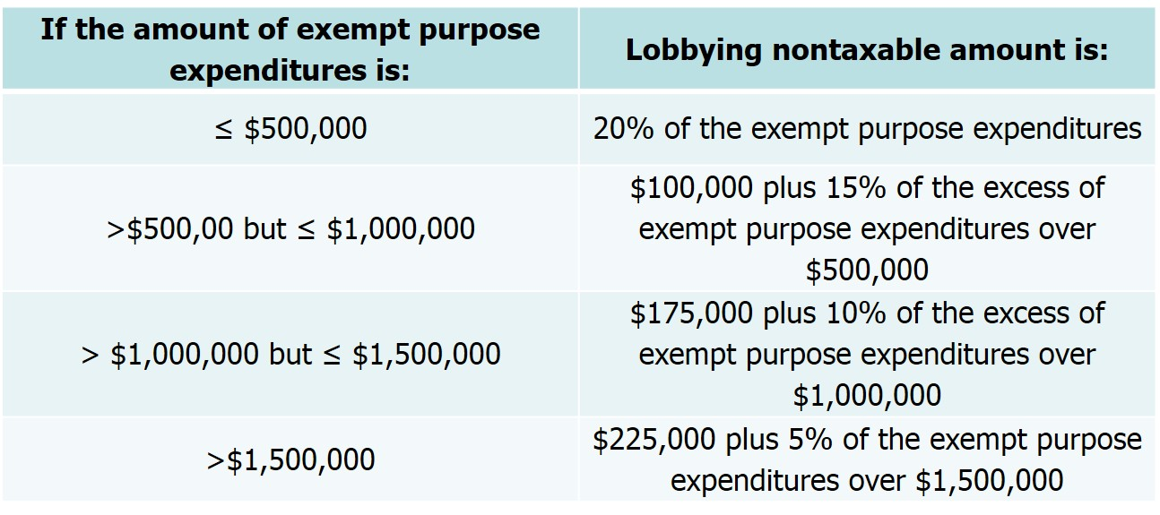
IRS Lobbying Rules for Charities, cont’d. 3
§501(h) Safe Harbor Registration
Maximum lobbying expenditures are based on total expenditures as follows:
25% of the above amounts are allowable for grassroots lobbying

Slide 8
IRS Lobbying Rules for Charities, cont’d. 4
Political Parties and Candidates:
Unlike lobbying, certain involvement with political candidates or political parties is strictly prohibited and can lead to revocation of your exempt status.
Charities need to avoid supporting or opposing candidates for public office.
Charities cannot allow paid employees to work on behalf of a candidate or political organization while receiving compensation.
Campaigning AGAINST a candidate has the same effect as campaigning FOR one.

Slide 9
IRS Lobbying Rules for Charities, cont’d. 5
Political Parties and Candidates:
This prohibition also extends to contributions to candidates’ campaigns, engaging in fund-raising activities, distributing statements and similar activities.
You cannot use organization resources for a candidate’s golf tournament or fundraising event.
You cannot allow a candidate or political organization to use your facilities or equipment.
Watchdog organizations monitor nonprofits, informing the IRS about violations of the rules prohibiting involvement in political campaigns.

Slide 10
Resources on Lobbying Rules for Charities
Additional information about lobbying guidelines can be found at www.independentsector.org.
Look at the policy & advocacy tab of their website.
This can be a one-stop shop for rules and requirements as well as advocacy skills and information on how to contact your legislators.

Slide 11
CIL-NET Attribution
Support for development of this technical assistance information was provided by the Department of Health and Human Services, Administration for Community Living under grant number 90TT0001-02-00. No official endorsement of the Department of Health and Human Services should be inferred. Permission is granted for duplication of any portion of this information, providing that the following credit is given to the project: Developed as part of the IL-NET, an ILRU/NCIL/APRIL National Training and Technical Assistance Program.

