Slide 1
Independent Living Research Utilization

Slide 2
Get to the Core of It: Integrating CIL Core Services for a Holistic Consumer Experience Seamlessly Integrating Serving Youth in Transition into Core Services Presenters: Kimberly Tissot Charlie Walters May 3, 2018 Tempe, AZ

Slide 3
Services to Youth in Transition Defined
Facilitate the transition of youth who are individuals with significant disabilities, who were eligible for individualized education programs under section 614(d) of the Individuals with Disabilities Education Act (20 U.S.C. 1414(d)), and who have completed their secondary education or otherwise left school, to postsecondary life.
WIOA age range is “...not younger than 14 years of age; and is not older than 24 years of age.”

Slide 4
Services to Youth in Transition Defined
Youth who meet these definitions are a population (category), not a service. Any of the CIL’s services may be provided to someone who meets these definitions. It’s about how you categorize the person and report it, not about the services you provide.
When serving individuals who are pre-school, currently attending secondary education, or have passed the age of 24, these individuals are not categorized as being youth in transition in the program performance report (704 Report). They are reported as receiving the other core services. It’s a reporting issue, not a service issue!

Slide 5
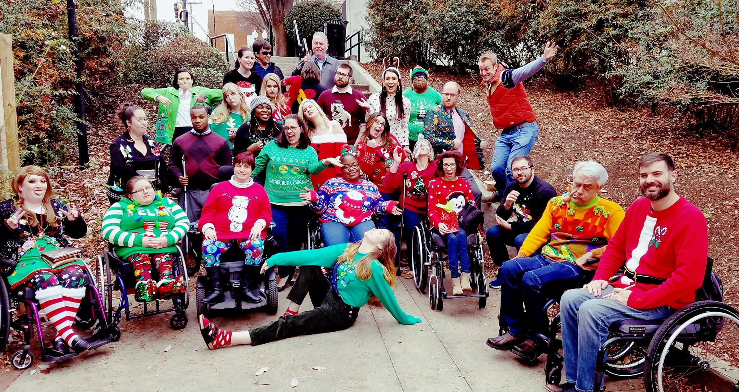
Able South Carolina
A South Carolina Center for Independent Living with a 23-county serving area
Most of our youth programs allow us to work statewide
Our focus is to provide one-on-one services & changing the culture around disability via advocacy and collaboration
47 staff members
Over 30 funding sources

Slide 6
Youth Served
Youth-driven IL now accounts for the majority of the services provided
2017: 867 between the ages of 5-24 (62%)
2016: 696 between the ages of 5-24 (56%)
2015: 713 between the ages of 5-24 (59%)
2014: 157 between the ages 5-24 (26%)
2013: 135 between the ages 5-24 (21%)
Transition (IDEA) vs. Youth Transition (CILs)
Serving youth while in school is the foundation for providing programming for Youth in Transition.
Notes:
These numbers are only services that are provided one-on-one, does not include youth who participate in group trainings.

Slide 7
Our Foundation for Youth Transition
The value of original core services to youth in transition runs deep.
What is needed to ensure those services are offered, expanded, and tailored to all youth in transition?
Leadership buy-in
Staff expertise on the context of youth transition (WIOA, IDEA, HCBS Final Rule, best practice, etc.)
Youth with disabilities driving programs.
Purposeful synergy between programs as expansion occurs.
Relationship building and involvement in transition at every turn.

Slide 8
EQUIP
A leadership program for youth (age 13-28).
Run by young adults.
Funding to bring standout leaders on staff.
Peer to peer skill development in self-advocacy, communication, and related skills.
Reached 8,000+ youth and other community members last year.
Stakeholders
Foundational component of other youth programs.
Developing youth expertise in IL

Slide 9
EQUIP, cont’d.
Multiple Components
Regional and online monthly “hangouts” (6 regional, 1 online)
Summer Series
Professional development and mentorship for leaders
Service on boards and committees
Training for families, professionals, and other youth

Slide 10
EQUIP, cont’d. 2
$113,500/Annually - SC DD Council, PTI, and SPIL
Run by young adults for young adults
EQUIP Stakeholders Group with 15 partners
1 Full-Time Coordinator, 6 part-time staff, 15 paid youth leaders
FCSC pays $26,000; SPIL provides $14,500
Notes:
Talk about terms, started with SPIL funding, then subcontracted with National Youth Leadership Network, then the program was picked up by DDC

Slide 11
Youth Leadership Forum
The SC YLF is open to young adults with any type of disability who are juniors, seniors, or recent high school graduates.
4 day, 3 night leadership experience.
Collaborates with multiple agencies to assist with recruitment, staffing, etc.
25 youth with disabilities attend the Forum.
SC YLF Alumni Association
Forum run and led by a majority of youth with disabilities.

Slide 12
Youth Leadership Forum, cont’d.
Connects with legislators and experiences public transportation.
Speakers within the disability community.
Self-Advocacy, leadership, employment, mentoring, confidence building.
History of SC YLF with parent organization; transitioned to Able SC 3 years ago.

Slide 13
Youth Leadership Forum, cont’d. 2
$50,000/Annually — SC DD Council
Planning committee made up of professionals & peers.
1 part-time Coordinator, 11 part-time staff, EQUIP Leaders.
Partners with the SC CIL Network for YLF event staffing.

Slide 14
Mapping Your Future and Empowering a Future
Statewide transition conferences
One day for educators, VR staff and transition professionals; the second day for family and youth.
Focuses on empowerment, disability rights, community resources that promote independence, successful transition stories, and raising expectations.
Collaborate with P&A, FCSC, DOE, TASC, I’m Determined.
Mapping Your Future was SC’s first transition conference in 2013.

Slide 15
Mapping Your Future and Empowering a Future, cont’d.
$30,000/Annually - SC DOE + Sponsor Support
5 part-time staff
Statewide

Slide 16
Pre-Employment Transition Services
Equips students with the tools and confidence to be successful as they get ready for life after high school
Work-Readiness Training
Self Advocacy
Career Exploration
Post-Secondary/High Education Exploration
Funding by SC Commission for the Blind, not our state’s VR

Slide 17
Pre-Employment Transition Services, cont’d.
$325,000/Annually - SC Commission for the Blind
2 part-time Coordinators (midlands/upstate), 10 PT Program Staff
Funding by SC Commission for the Blind (not our state’s VR)
Other CILs participate

Slide 18
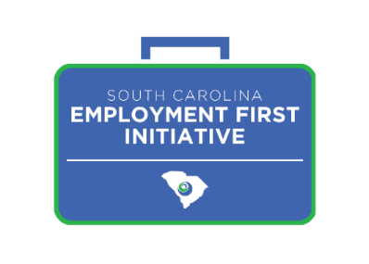
SC Employment First Initiative
Equip high school students, and those who recently exited, to enter competitive employment
Establish procedures for collecting student employment data.
Implement an employment model and peer mentoring program based on current successful practices.
Initiate a social media campaign to engage youth discussion regarding disability in employment.
Accomplish cross-system implementation of Employment First principles
Instill Employment First training across service systems.
Launch a statewide campaign to improve community perception of disability in employment.
Notes:
Able SC is one of six states in September 2016 to be selected by the Administration on Community Living to receive funding in order to increase employment outcomes for youth with intellectual and developmental disabilities statewide. Employment First emphasizes competitive, integrated employment as the preferred option for individuals with disabilities.
Discuss the MOU process, contract, goals, history, collaboration efforts, term, our plan to sustain

Slide 19
SC Employment First Initiative, cont’d.
Conduct benefits trainings to dispel myths regarding working and benefits
Provide supports for employers to promote hiring and retention of persons with disabilities.
Offer employer trainings about best practices in inclusive employment.
Implement a targeted campaign to improve employer perceptions of disability.
Publish a listing of supports for employers.
Host an employer summit to promote inclusive workforce development.
Notes:
Able SC is one of six states in September 2016 to be selected by the Administration on Community Living to receive funding in order to increase employment outcomes for youth with intellectual and developmental disabilities statewide. Employment First emphasizes competitive, integrated employment as the preferred option for individuals with disabilities.
Discuss the MOU process, contract, goals, history, collaboration efforts, term, our plan to sustain

Slide 20
SC Employment First Initiative, cont’d. 2
$250,000/annually - Administration on Community Living
1 full-time Director of Employment, 10 part-time staff
Subcontracts with SC CILs
Partners with SCVRD, DOE, USC UCEDD, P&A, DDC, SCCB, DEW, FCSC, WOIL, AA, & DDSN
Notes:
Discuss the MOU process, contract, goals, history, collaboration efforts, term, our plan to sustain

Slide 21
SC Parent Training and Information (PTI) Center—Family Connection of SC
PTIs are parent-led organizations
Able SC implements the youth component of the PTI grant.
Provide self-advocacy training.
Provide IL skills to youth.
Provide training to parents re: disability rights/self advocacy.
Co-facilitate parent/youth advisory council.
Free to Be Me.
Provide TA for parents WITH disabilities.
Notes:
Give background about this grant

Slide 22
SC Parent Training and Information Center (PTI)
$26,000/Annually - Family Connection of SC (SC’s PTI)
Assists with funding EQUIP
7 part-time program staff
Assisted in the process of writing this grant
New PTI
Notes:
Give background about this grant

Slide 23
School Visits
Able SC is actively involved with several school districts in South Carolina.
We provide disability pride, self-advocacy, employment and independent living skill-building opportunities through engaging, interactive activities and discussion with peer mentors in the classroom.
* Promote independent living, disability awareness, inclusion in general education classes, self advocacy, peer mentoring, and collaboration among agencies (I&R)
*Success after high school for youth is directly linked to the above services. CIL services help bridge the research to practice gap!

Slide 24
One-to-One Youth Skill Building
Our Independent Living Specialists work one on one with young adults throughout the Midlands and Upstate on consumer-directed independent living goals, such as directing their own IEP, employment preparation, cooking, budgeting, securing transportation and affordable housing, and much more.
We have youth-focused independent living specialists.

Slide 25
School Visits, cont’d.
$70,000/Annually - SC DOE
4 part-time staff members
Changes the culture in schools
Works closely with the SC Department of Education

Slide 26
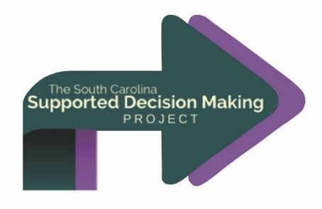
SC Supported Decision Making Project
Inform individuals and families about their options, including using a combination of supports (like representative payee, Power of Attorney, Able Savings accounts, etc.), and assist individuals and their families with creating and implementing a Supported Decision Making agreement.
Goal is to prevent unnecessary guardianships which strips individuals of their rights and independence.

Slide 27
SC Supported Decision Making Project, cont’d.
$23,000/Annually - SC DD Council
Provides outreach/statewide resources
4 part-time staff
Subcontracts with Protection & Advocacy, Parent Training & Information, and Arc of SC
Notes:
TA via Jonathan Martinez

Slide 28
Work Incentive Planning and Assistance (WIPA)
Benefits Counseling—a transition essential!
For individuals ages 14 - full retirement age, who receive or are entitled to SSA benefits, typically Social Security Disability Insurance (SSDI) and/or Supplemental Security Income (SSI).
The services include: A review of the individual’s benefits; Discussion of current and future impact of employment; Comprehensive written outline of options available to support informed choice.
Youth focus and collaboration with schools and transition professionals.

Slide 29
Work Incentives Planning and Assistance, cont’d.
$155,000/Annually - WIPA Grant
Provide work-incentive trainings/ youth focused
3 full-time staff, 2 part-time staff
Subcontractor with the state’s WIPA lead, Walton Options (CIL)
Provides outreach to educators

Slide 30
Community Leadership Academy (CLA)
Training in leadership and professionalism towards serving on boards, committees, and other community roles.
Teaches individuals how to use their voice on boards, committees, and councils (i.e. ADA, inclusion, disability awareness).

Slide 31
Professional Development/Technical Assistance
Empowering a Future.
Technical assistance for professionals in Supported Decision Making, Student-Led IEPs, Disability Sensitivity, and Disability Rights.
Providing consultation regarding the accessibility of school buildings, including playgrounds.
Serve on transition teams via TASC.
Fee for service.
All Able SC staff are required to get 18 hours of professional development to increase knowledge.
ALL other Able SC services are inclusive to youth!

Slide 32
Other Able SC Transition Programming
Southeast ADA Center – State Affiliate
Develops disability rights training for school system
SC Disability Employment Coalition – Project RISE
Transition to Careers

Slide 33
Tips for Collaboration
Don't be the “best kept secret.”
Collaborate with local disability-related organizations, school districts, colleges, etc.
BE ACTIVE with education programs for youth with disabilities such as IDEA Advisory Councils, Parent Training and Information Centers, statewide transition efforts, VR, etc.
Practice what you preach!

Slide 34
Resources for Serving Youth In Transition
Links for recorded webinars and video modules – http://www.ilru.org/topics/youth-transition
Youth Transition: The Growing Role of Centers for Independent Living (recorded video modules) - http://www.ilru.org/training/youth-transition-growing-role-centers-for-independent-living
Expanding CIL Capacity Through Youth-Driven Transition Services (training manual) - http://www.ilru.org/expanding-cil-capacity-through-youth-driven-transition-services
ACL Letter Announcing FAQs on IL Services for Children and Youth with Disabilities - http://www.ilru.org/federal-guidance-il-program

Slide 35
Group Discussion & Activity
What have you done towards creating strong youth programming at your CIL?
What have you learned?
Where do you need to build community relationships?
Is the current nature of relationships harming you?
Solution-oriented vs. problem oriented
How are you building the next generation of leaders in IL?
What is your vision for your CIL and how do youth fit in?
Notes:
What is a Core Service?
Centers for independent living provide services to individuals with a range of severe disabilities from cross-disability multicultural populations. The core services that centers for independent living provide are individual and systems advocacy, peer counseling, information and referral, and independent living skills training.
In addition to promoting and practicing the independent living philosophy, CILs are required to provide the following four core services: (1) Independent Living Skills Training teaches people with disabilities basic life skills toward becoming independent, or maintaining and enhancing independence. Examples include budgeting, self-advocacy, using public transportation, cooking, and stress management; (2) Advocacy Programs offer assistance in navigating through administrative networks to obtain services such as housing and health care. Advocacy programs also operate at the systems level to initiate, promote and protect public policy for the benefit of people with disabilities; (3) Peer Support Programs match people with disabilities who have similar circumstances and goals. A person who is adapting to life with a disability, transitioning to adulthood or to living more independently, may benefit from working with a peer who has experience and knowledge to share; and,
(4) Information & Referral Services are important because knowledge is power. Individuals may call when needing information on disability-related issues such as housing, employment, assistive technology, and legal issues. CILs maintain information on disability and community resources and refer callers appropriately.
Page 16
Roles and Responsibilities of CILs
In addition to promoting and practicing the independent living philosophy, CILs are required to provide the following four core services: (1) Independent Living Skills Training teaches people with disabilities basic life skills toward becoming independent, or maintaining and enhancing independence. Examples include budgeting, self-advocacy, using public transportation, cooking, and stress management; (2) Advocacy Programs offer assistance in navigating through administrative networks to obtain services such as housing and health care. Advocacy programs also operate at the systems level to initiate, promote and protect public policy for the benefit of people with disabilities; (3) Peer Support Programs match people with disabilities who have similar circumstances and goals. A person who is adapting to life with a disability, transitioning to adulthood or to living more independently, may benefit from working with a peer who has experience and knowledge to share; and,
(4) Information & Referral Services are important because knowledge is power. Individuals may call when needing information on disability-related issues such as housing, employment, assistive technology, and legal issues. CILs maintain information on disability and community resources and refer callers appropriately.

Slide 36
CIL-NET Attribution
Support for development of this technical assistance information was provided by the Department of Health and Human Services, Administration for Community Living under grant number 90ILTA0001. No official endorsement of the Department of Health and Human Services should be inferred. Permission is granted for duplication of any portion of this information, providing that the following credit is given to the project: Developed as part of the CIL-NET, a project of the IL-NET, an ILRU/NCIL/APRIL/USU-CPD National Training and Technical Assistance Program.

