Slide 1
Slide 1 Independent Living Research Utilization

Slide 2
New CIL and SILC Staff Members Training and Technical Assistance Series: An Introduction to Digital Accessibility
November 8, 2023
Presenters:
Mary Reaves
Sarah Massengale

Slide 3
1A11y, Overlay, WCAG, Oh My! What does it all mean?
Sarah Massengale, CPACC
Mary Reaves, MRC
An Introduction to Digital Accessibility

Slide 4
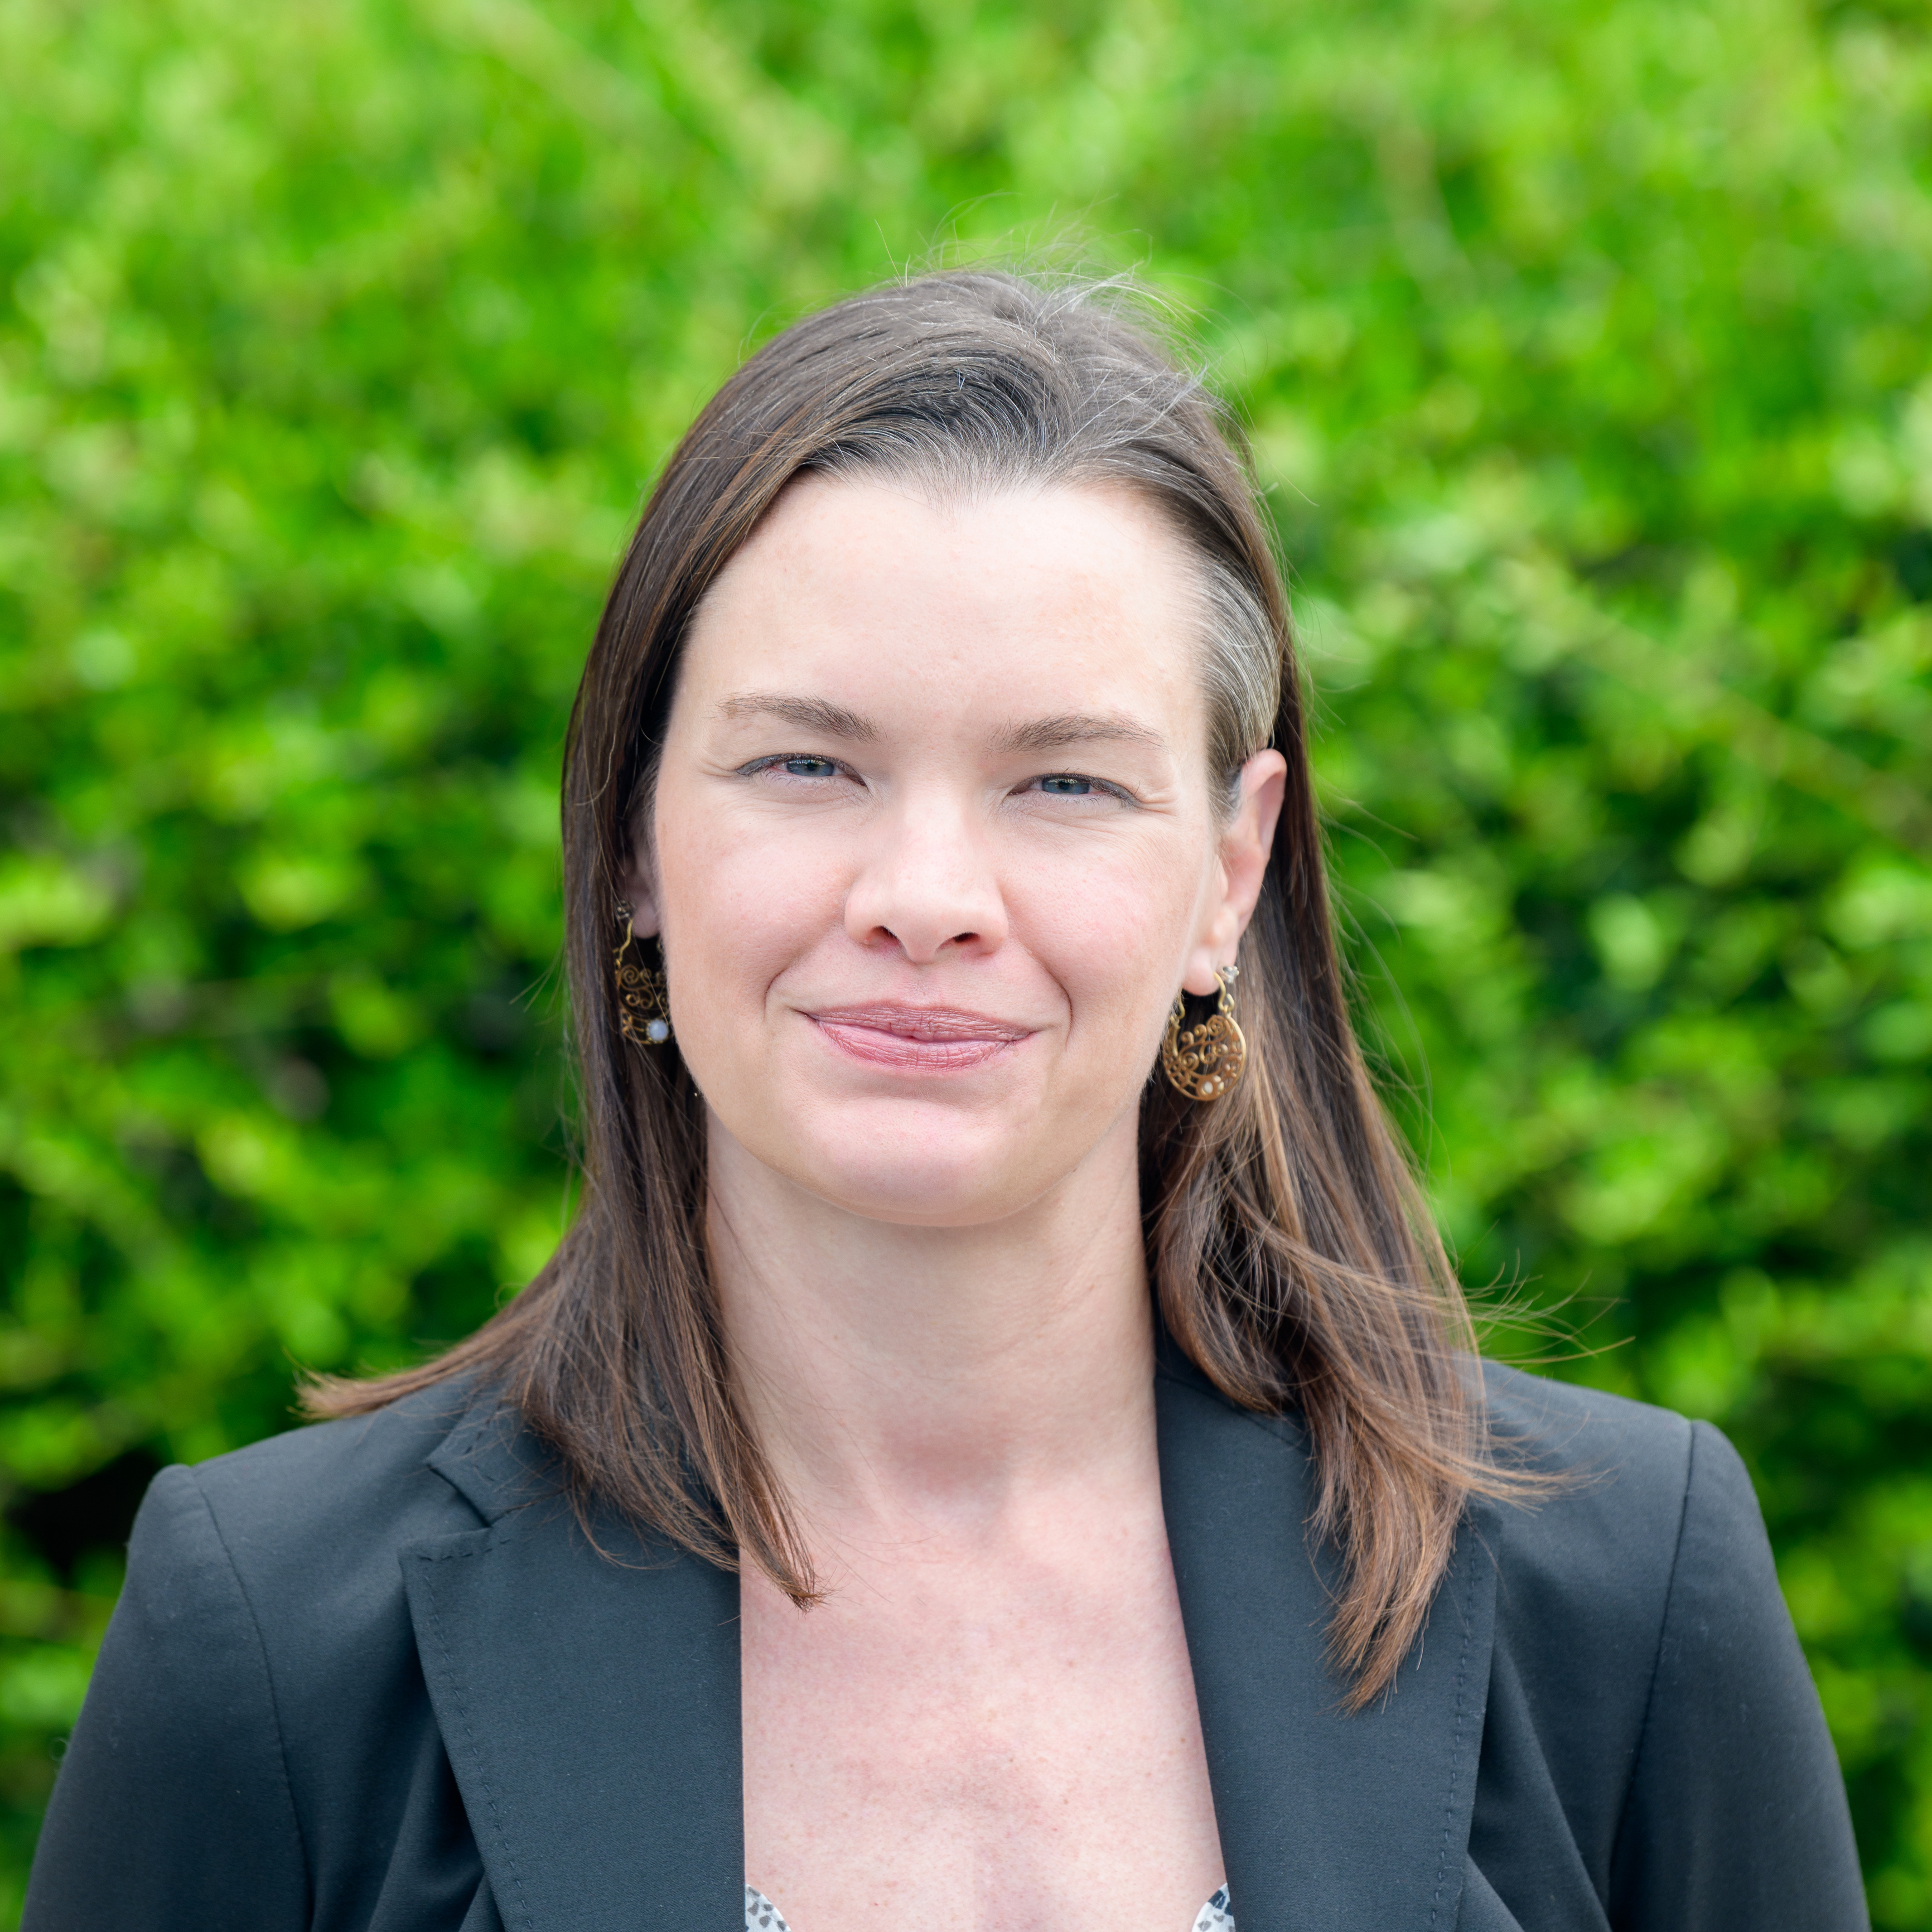
2Today's Presenters
Sarah Massengale
She/Her/Hers
Community Access Specialist
Mary Reaves
She/Her/Hers
Director of Community Access
Image of Sarah Massengale smiling.
Image of Mary Reaves smiling.
Notes:
Sara and Mary - Ensure we talk about disability led, come at this from a cross-disability perspective. Mission and vision – oldest and largest center for independent living.

Slide 5
3Training Objectives
After this training, you should be able to:
Identify the reasons why digital accessibility (a11y) is important
Understand the difference between designing with accessibility in mind and remediating after the fact
Identify places where digital accessibility should be a consideration, documents, websites, etc.
Understand the role of Centers for Independent Living CILs in providing and ensuring accessibility
Notes:
Mary cover these.

Slide 6
Slide 4: Housekeeping Notes
Please use the chat as little as you can. It interrupts screen readers
When you have questions, please ask. There is nothing better for learning than healthy discussion
There are no right or wrong, good or bad questions in this space. Your presenter is not only an expert, but a person with a disability and lived experience. Now is a great time to ask anything you’re curious about!
Check in: your presenter is blind, which means body language cues are sometimes missed. If something is overwhelming, content is too fast, etc. speak up
Just like questions are highly encouraged, so is feedback. If you need more information, the presentation style isn’t working for you, you have your own tips and/or experiences to share, please feel welcome to do so.

Slide 7
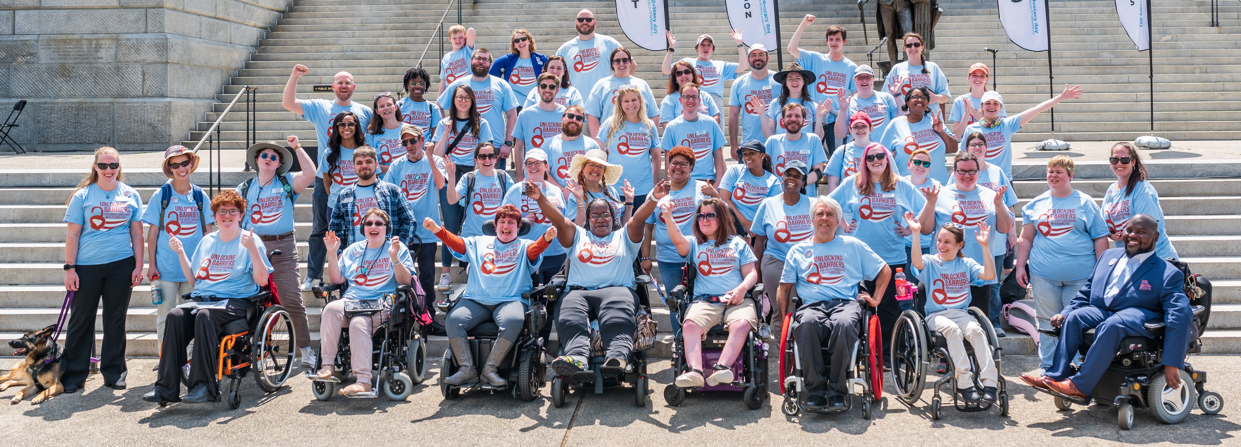
5Able SC’s Mission & Vision
Mission​
We are an organization of people with disabilities leading the charge to: ​
​
Equip people with disabilities with tools to foster pride and to direct their own lives;​
Educate the community to challenge stereotypes and eliminate barriers; and​
Advocate for access, equity, and inclusion at the individual, local, state, and national level. ​
Vision​
A South Carolina that is a national model of equity and inclusion for all people with disabilities.​
Image of the Able SC team at Advocacy Day in front of the SC State House
Notes:
Mary

Slide 8
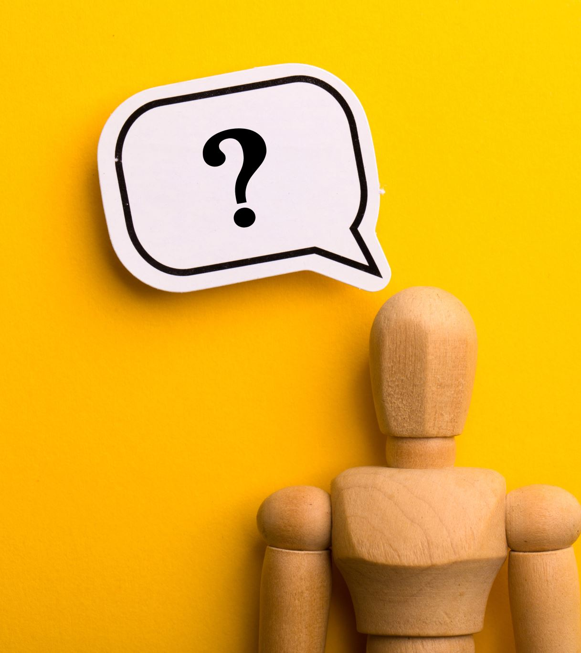
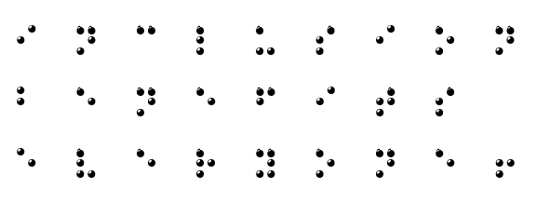
6Why Accessibility?
Inclusion
benefits
everyone!
Notes:
Sarah, explain how we use Braille and why and link how this is important because folks who use Braille, they would use that on paper = and so if people use a website, it needs to be accessible, it is the same as accessing a piece of paper. Explain how even accessing the internet works.

Slide 9
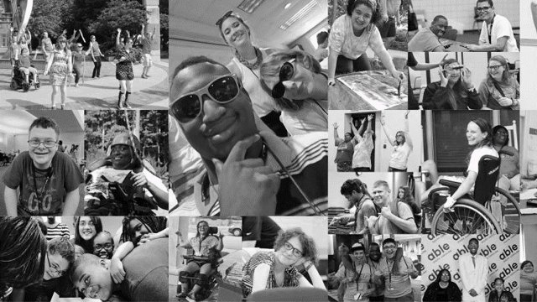
7Who are People with Disabilities?
Disability represents the largest marginalized community:
1 in 4 Americans has a disability
1 in 3 South Carolinians has a disability (over 1.2 million people)
Disability crosses all social, racial, and cultural groups.
Accessible communication benefits everyone!
Notes:
Mary does this one.

Slide 10
8How People with Disabilities Use Digital Content
People with disabilities engage with digital spaces for a
variety of reasons including:
Shopping
Travel
Social media
Information gathering
Communication
News
Events
Weather
Job Postings
Educational Opportunities
All the same reasons people without disabilities use digital content! ​
Notes:
Sarah - let's ask them what they use the internet for and then remind – yep, same! Might even want to mention the playboy law suit. Ask folks to raise their hands with the various ways they used the internet this morning/today.

Slide 11
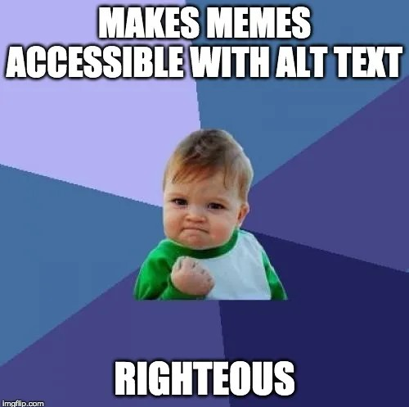
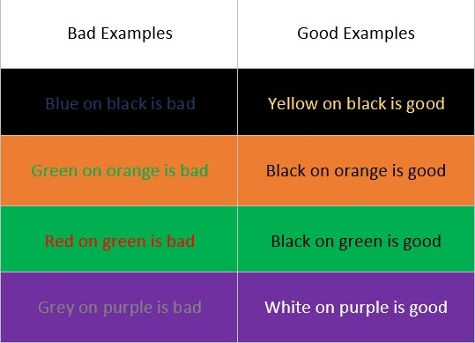
9What Prevents People with Disabilities From Using Digital Content
Links that are not labeled correctly
Example, just says "click here"
Poor color contrast
Images that include text
No captions
Does not support speech to text
(e.g. Dragon software)
Stacking images: 1 – 2 columns of examples of good and bad color contrast, 2- meme with baby making a fist and text that reads makes meme accessible with alt text – righteous.
Notes:
Sarah – talk about HOW to make Alt Text and explain how captions can be added.

Slide 12
10What is Digital Accessibility (a11y)?
Digital accessibility is the term given to all the considerations that, when brought together, make sure that websites, digital documents, presentations, social media, or any other content that is present in digital spaces is equitably accessible to people with a wide variety of disabilities.
While many of the considerations for digital accessibility apply to individuals with visual disabilities and the Assistive Technology (AT) they use such as screen readers and screen magnifiers, digital accessibility can also encompass people with cognitive and intellectual disabilities, motor disabilities, and others.
Notes:
Sarah

Slide 13
11Digital Accessibility is the Law!
Sections 508 & 504 of the Rehabilitation Act of 1973, as amended
The Americans with Disabilities Act (ADA) 1990
This includes Web Content Accessibility Guidelines (WCAG)
Individuals with Disabilities in Education Act (IDEA)
Plain Writing Act (PWA)
Notes:
Mary - SM to talk about Dominos and MJR aboutPlayboy, Netflix ( the first ruling in the country to recognize that Internet-based businesses are covered by the act. Such Web-based businesses did not exist when the law was enacted in 1990, but according to the judge, it was intended to adapt to technology changes.)

Slide 14
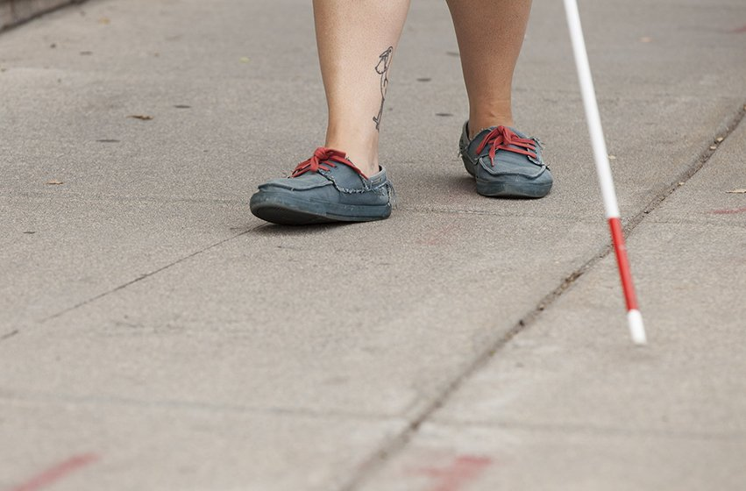
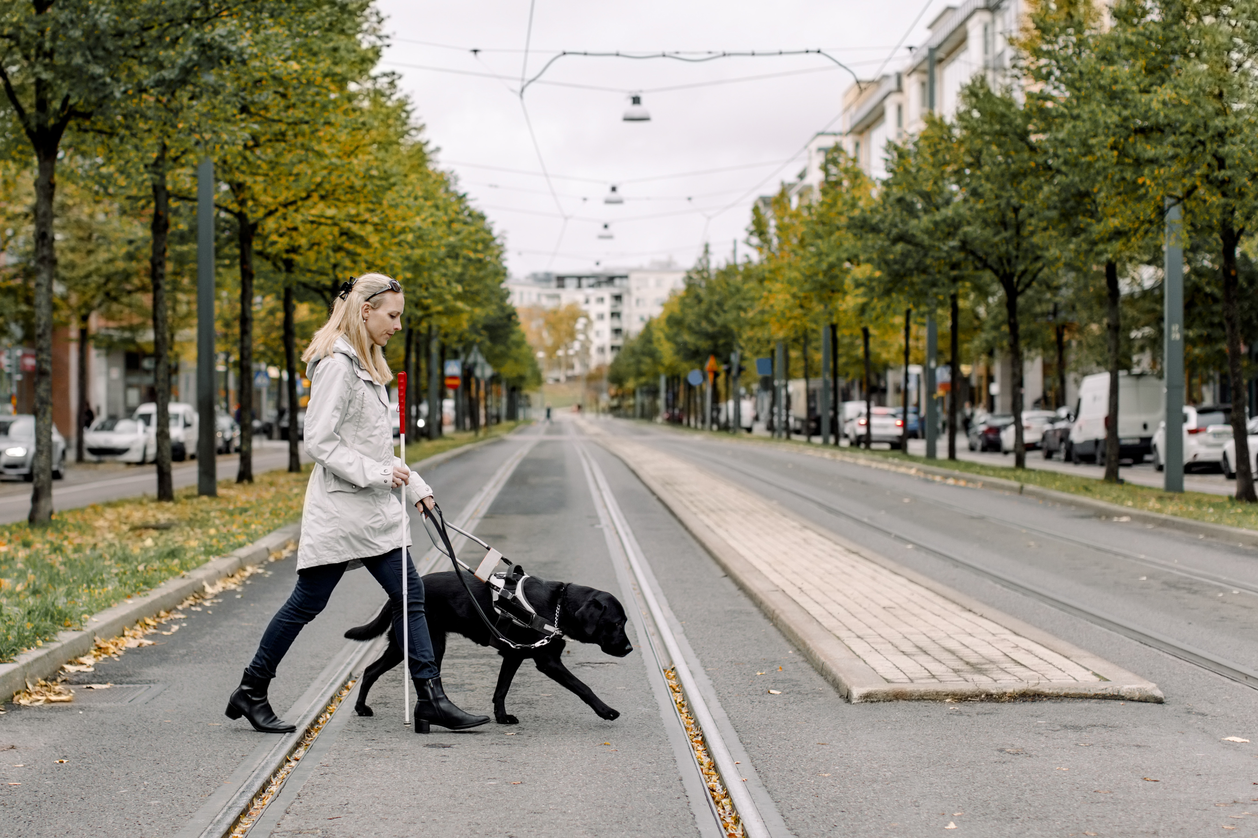
12What is Assistive Technology (AT)
Assistive technology might include mobility aids such as white canes or wheelchairs, access software such as screen readers and screen magnifiers, or devices such as communication boards.
Assistive technology is any solution or device, whether high or low tech, that allows people with disabilities to participate equitably in society.
Image of lower part of legs and a white cane on a street.
Image of a woman crossing the street with a guide dog.
Notes:
Sarah

Slide 15
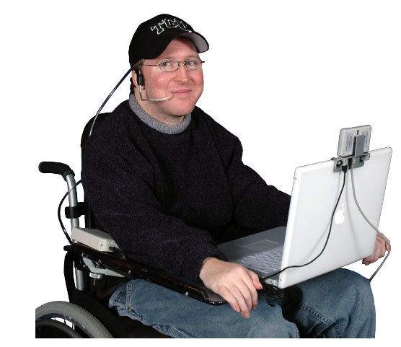
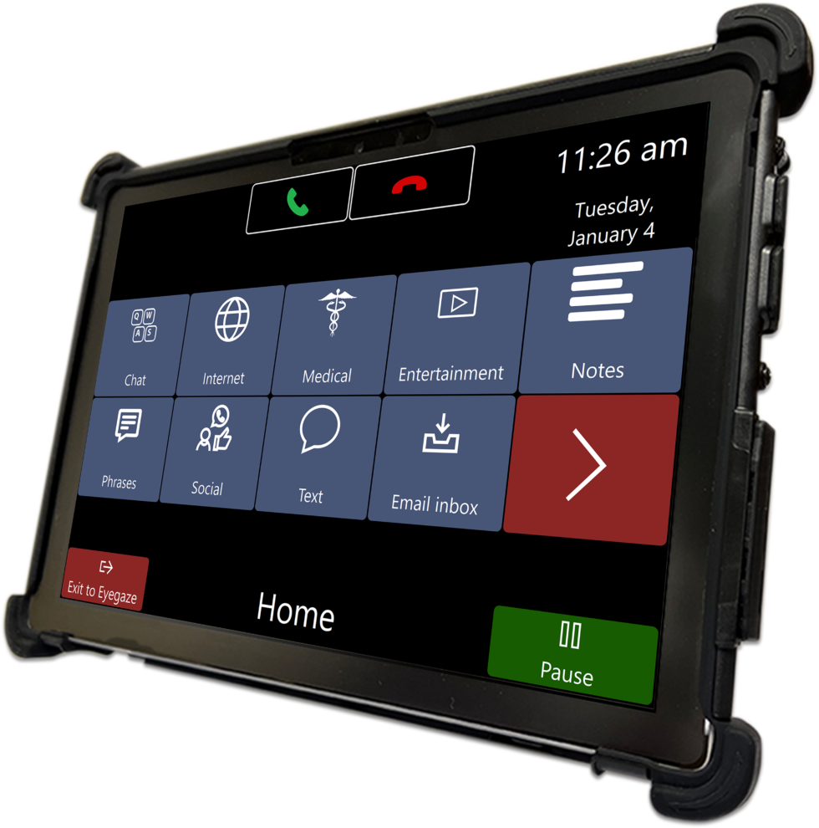
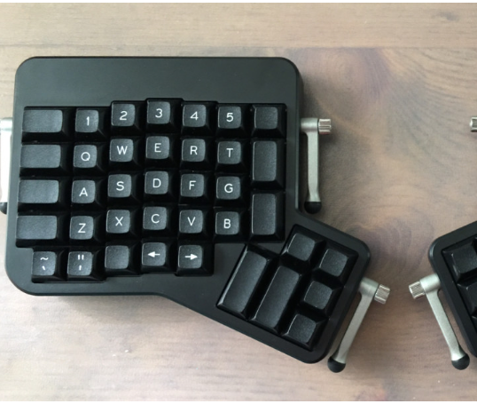
13Common AT You May Encounter in Digital Spaces
Image of a man in a wheelchair using Sip and Puff AT
Screen Readers
JAWS, Voice Over
Speech to Text
Alternative keyboard layouts
Eye Tracking/Eye Gaze
Sip and Puff
Augmentative Communication aids
Image of a tablet displaying eye tracking software
Image of an alternative keyboard – split in two with switches on 4 sides.
Notes:
Mary – associate some disabilities –
eye gaze: quads, ASL, unable to use hands,
Speech to text – limited mobility, intellectual disabilities, dyslexia

Slide 16
14What is Plain Language?
Communication that is made to ensure as many people as possible can read, understand, and process the information given
Plain Language uses everyday language that is accessible to everyone
It helps:
People with low literacy
People who speak English as a non-native language
People with disabilities
16

Slide 17
15Basic Considerations for Digital Accessibility
Document Accessibility (including Word, PDF, PowerPoint, Excel)
Accessible platforms and inaccessible collaborative platforms (Google Drive vs OneDrive vs Dropbox
Considerations of internal databases and limitations
Notes:
Sarah- talk about CIL Suite, time card system, University-type databases (CSM, Accom, etc)

Slide 18
16Alternative text and image descriptions
Alt Text= Alternative Text​
Purpose: to provide description of visual content and information​
Primarily for people who are blind or low vision​
To be used for photos, graphics, GIFs, tables, charts, etc.​
Alt text vs. image description:​
Alt text: shorter, coded​
Alt text is read by screen reader AT.​
Image description: sometimes longer, in post or caption​
Image description benefits everyone!
18

Slide 19
17Colors and Fonts
Be sure that documents and webpages use high contrast colors such as black and white, black and red, Etc.
Be careful with blues and greens so that text is easily read by people who are color blind
Be sure that fonts are large enough to be read easily
Always use sans serif fonts
19

Slide 20
18Headings and Links
Headings:
Are used to categorize content in a document or on a webpage
Think like this:
Title, chapters, parts, and so on.
Should use correct heading hierarchy
Should be created using styles pane in Microsoft Word or coded correctly on a webpage
Not enough to change color and font size only
Links:
Should have meaningful link text
Not enough to say read more or click here
Example: You can learn more about my work through reading my resume.
20

Slide 21
19Designing with Accessibility in Mind
As you build web content, documents, presentation or platforms, are you considering the Web Content Accessibility Guidelines
What automated testing tools are you using to establish a baseline for the accessibility of your content?
Are qualified people with disabilities testing your website/document/presentation/platform before it goes live
In addition to compliance, are you considering additional usability considerations
Notes:
Sarah

Slide 22
20Beware Quick Fix Products for Digital Accessibility
Recently, the trend of the Accessibility Overlay has emerged. These products claim to be a quicker, easier and less expensive way to remediate websites and platforms.
The facts:
The web content accessibility guidelines have hundreds of individual criteria, but a digital accessibility overlay is one single line of code
Digital accessibility overlays provide one preset group of accommodations and website alterations for each identified disability group. They do not consider that people with the same disability often have differing needs and differing ways of navigating the internet
As an alternative to providing concise and helpful alternative text to images, overlays simply hide images
Overlays allow for cross-site tracking and storing of information about a user’s assistive technology
IAAP Position Statement: https://www.accessibilityassociation.org/s/overlay-position-and-recommendations#Overlay%20Position%20Statement​
Notes:
Sarah - How much can we say about Overlays and such with the current lawsuit. https://overlayfactsheet.com/
False Claims white paper: https://overlayfalseclaims.com/
IAAP Position Statement: https://www.accessibilityassociation.org/s/overlay-position-and-recommendations#Overlay%20Position%20Statement

Slide 23
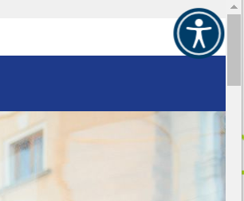
21What is an Overlay?
Building images:
1 – Small picture of just the accessibility icon from a website with an overlay
2 – The full page open and the accessibility and the accessibility widget showing
3 – full page open and hide images selected displaying only text with color borders.
Notes:
Sarah

Slide 24
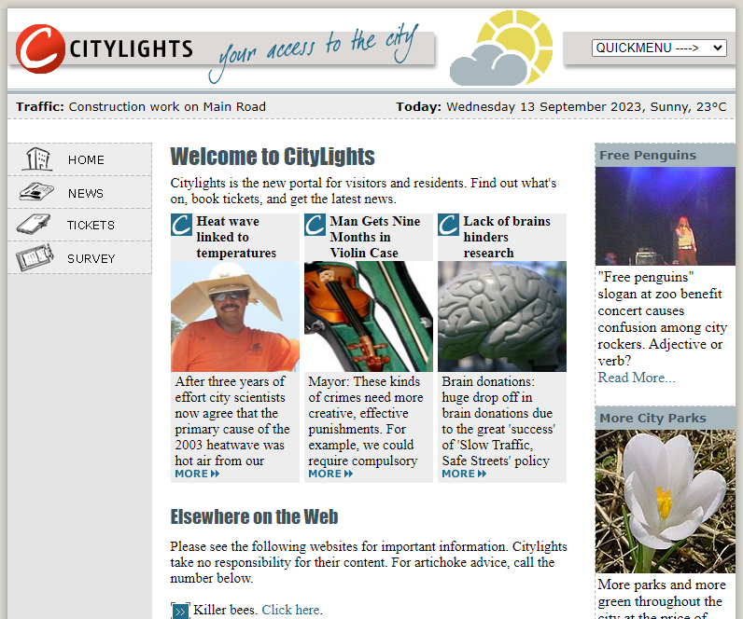
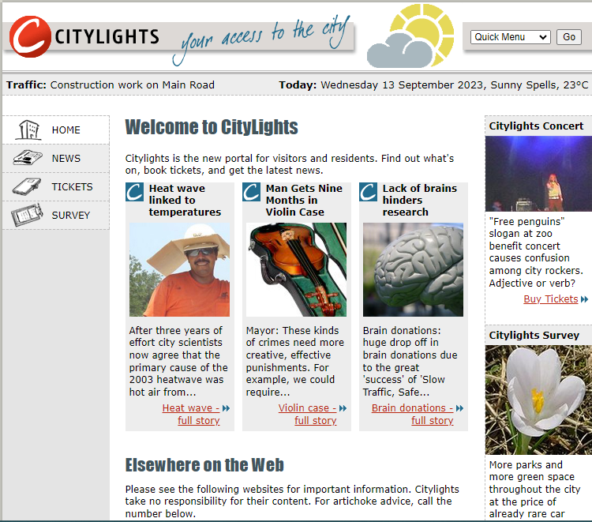
22Inaccessible Content vs. Accessible Content
Inaccessible Website​
Accessible Website
Notes:
Sarah

Slide 25
23Resources
Alternative Keyboards
https://gist.github.com/dustypomerleau/29f5311089767cfbe5915c5743035710
Eye Tracking devices and resources
https://sc.edu/study/colleges_schools/medicine/centers_and_institutes_new/center_for_disability_resources/assistive_technology/resources/augmentative_alternative_communication/index.php\
Sip and Puff Technology and information
https://www.orin.com/access/sip_puff/
WebAIM for web development, documents, and contrast checking
https://webaim.org/resources/
WebAIM Accessibility Checker – for websites
https://wave.webaim.org/
Notes:
Mary

Slide 26
24Resources
Adobe Contrast Checker
https://color.adobe.com/create/color-contrast-analyzer
Access South Carolina IT (ASCIT)
https://ascit4all.org/
WCAG
https://www.w3.org/TR/WCAG21/
WCAG in plain language
https://www.tempertemper.net/blog/wcag-but-in-language-i-can-understand
Augmentative Communication aids
https://sc.edu/study/colleges_schools/medicine/centers_and_institutes_new/center_for_disability_resources/assistive_technology/resources/augmentative_alternative_communication/index.php
Notes:
Mary

Slide 27
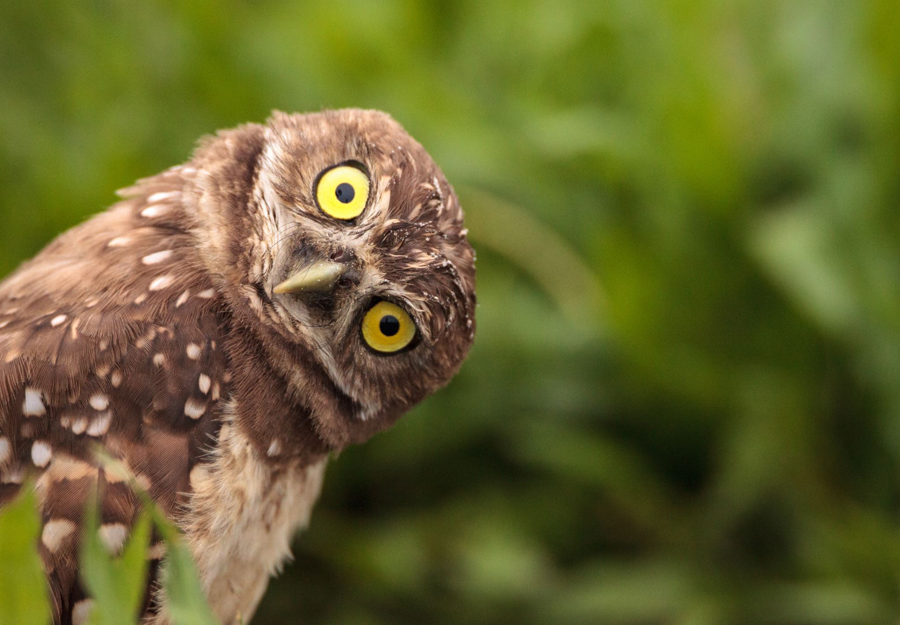
25Questions?
Image of an owl looking quizzically at the camera.
Notes:
SaRAH

Slide 28
26 Able Access
Architectural Assessments
Digital Accessibility testing and training (web, documents, social media)
Policy and Procedure Review
Job-site assessments and recommendations
Notes:
mARY

Slide 29
27 Contact us
Social Media:​
Facebook: @AbleSC​
Twitter: @able_sc​
Instagram: @able_sc​
LinkedIn: Able South Carolina​
YouTube: Able South Carolina​
Email: info@able-sc.org
Phone: 803-779-5121
TTY: 803-779-0949
Columbia, SC Office: 720 Gracern Rd. Suite 106
Greenville, SC Office: 135 Edinburgh Ct. Suite
101Join Email List: Text ABLESC to 72572
Notes:
Mary

Slide 30
Slide 30 IL-NET (CIL-NET and SILC-NET) Attribution
Support for the development of this training was provided by the Department of Health and Human Services, Administration for Community Living under grant numbers 90ILTA0001 and 90ISTA0001. No official endorsement of the Department of Health and Human Services should be inferred. Permission is granted for duplication of any portion of this PowerPoint presentation, providing that the following credit is given to the project: Developed as part of the IL-NET, an ILRU/NCIL/APRIL National Training and Technical Assistance project.

