Slide 1
Slide 1 Independent Living Research Utilization

Slide 2
Slide 2 SPIL Training and Technical Assistance Monthly Series
Section 1.1-1.3 - Mission, Goals, Objectives
November 2, 2023
Presenters:
Sandra Breitengross Bitter
Jeremy Morris

Slide 3
Slide 3 What you will learn
How the mission, goals, and objectives will shape the core of your State Plan for Independent Living.
How developing an outcomes-based plan, following a logic model, can ensure Plan goals and objectives are reasonable and achievable.

Slide 4
Slide 4 Instructions and Instrument
State Plan for Independent Living Instructions and Instrument
This link will take you to a direct download of the latest instructions for the SPIL (expiring in 2026) and the instrument, which is the template for filling out your State Plan.
NOTE FOR LINK: All instructions (language not included in the SPIL Instrument itself) are in italics.

Slide 5
Slide 5 Outcomes-Focused and Using Logic Models
The mission, goals, and objectives should be outcomes-focused with clearly stated outcomes to be achieved.
A logic model may help you organize each goal and objective to ensure it stays on track toward a specific outcome.
When developing your logic model, it will be helpful to include the activities planned to achieve each objective–BUT you are not required to include activities in the SPIL for submission to ACL/OILP.
Appendix B of the Instructions and Instrument includes a sample logic model.

Slide 6
Slide 6 Outcomes vs. Outputs
Outputs are how much work is done:
Example: number of people served, hours of service, number of activities conducted, number of public service announcements, etc.
Outcomes are the changes or results you want:
Example: changes in individuals (knowledge, skills, etc, changes in organizations (attitudes, programs, etc.), changes in communities (attitudes, accessibility, etc.)

Slide 7
Slide 7 The Conceptual Chain
 |  |  | Then . . . | Mission Achieved
 |  | Then . . . | Goals Achieved
 | Then . . . | Objectives Achieved
If we do . . . | Activities
Notes:
A series of four steps with the bottom step labeled, "if we do...." Activities, "Then..." Objectives Achieved, "Then..." Goals Achieved, "Then..." Mission Achieved is written on the top step.

Slide 8
Slide 8 Sample Logic Model
Mission
Goal 1
Objective 1.1
Activity
Goal 2
Objective 2.1
Activity
Objective 1.2
Activity
Objective 2.2
Activity
Notes:
Image Description: "Mission", with blocks under, labeled as Goal 1, Goal 2. Beneath the Goals are listed Objectives 1.1, 1.2, 2.1, 2.2. Beneath the objective blocks is another block listed as "activity."

Slide 9
Slide 9 Section 1.1 Mission
1.1 Mission of the Independent Living Network and the SPIL.
In developing the mission statement, keep in mind this is the mission of the IL Network in your state and the SPIL is the vehicle to address it.
The mission is the highest outcome in the long term, and the SPIL goals and objectives should all be aiming toward achieving this mission.

Slide 10
Slide 10 Section 1.1 Mission, cont.
Examples:
“(state)ians with disabilities participate fully as they like in community activities.”
or
“(state)ians with disabilities are valued equally and participate fully in their communities.”
or
“The mission of the (state) Independent Living Network is to empower (state)ians with disabilities to live as independently as they choose.”

Slide 11
Slide 11 Section 1.2 Goals
Goals of the IL Network for the three-year period of the plan.
Goals are the intermediate outcomes, what you want to achieve, that build toward the mission.

Slide 12
Slide 12 Section 1.2 Goals, cont.
Examples:
“Individuals with disabilities live independently in the community.”
“Formerly underserved populations are served by CILs.”
“Network Capacity and Sustainability: The Independent Living Network operates effectively, is adequately funded, and has the capacity to expand.”
“Establish a statewide network of centers for independent living.”

Slide 13
Slide 13 Section 1.3 Objectives
Objectives for the three-year period of the plan – including geographic scope, desired outcomes, target dates, and indicators. Including compatibility with the purpose of Title VII, Chapter 1.
Objectives are specific outcomes – the changes you want to result from what you do – that build toward the achievement of a goal.
Objectives should be outcomes-focused, measurable, and have timelines/target dates.
Objectives may include specific amounts and sources of funding to be used for an objective or activity.

Slide 14
Slide 14 Section 1.3 Objectives, cont
Be realistic with objectives, and do not include more than can be achieved in the 3-year period of the plan.
**Do NOT include all the CILs work-plan objectives–the SPIL and the CIL work plans should work together but not duplicate each other. **
Measurable objectives include indicators–what information will tell you if you are being successful in achieving the objective–how you will know how fully the objective is being achieved.

Slide 15
Slide 15 Section 1.3 Objectives, cont.
Examples:
Goal 1. Individuals with disabilities live independently in the community.
Objective 1.1 Individuals with disabilities have access to transportation.
Indicator 1.1 Availability of accessible transportation increased by ___%.
Objective 1.2 Individuals with disabilities have access to the community-based resources they need.
Indicator 1.2 Waiting list for __________ Waiver was eliminate/reduced by ___%.

Slide 16
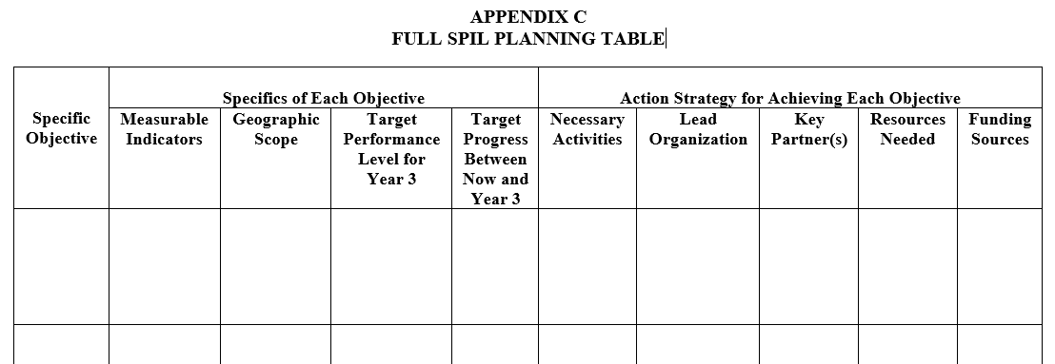
Slide 16 Section 1.3 Objectives, cont.
Notes:
"FULL SPIL Planning Table"
This is a blank table to be filled out for each specific objective; it lists the specifics of the objective and the action strategy for achieving each objective.
There is a row for each objective with columns with the following titles: Measurable Indicators, Geographic Scope, Target Performance Level for Year 3, Target Progress Between Now and Year 3, Necessary Activities, Lead Organization, Key Partner(s), Resources Needed, Funding Sources.

Slide 17
Slide 17 For on-going technical assistance, contact:
Paula McElwee
paulamcelwee.ilru@gmail.com
559-250-3082

Slide 18
Slide 18 Resources
The Rehabilitation Act:
Independent Living Regulations:
State Plan for Independent Living Instructions and Instrument:
SILC Indicators

Slide 19
Slide 19 IL-NET (CIL-NET and SILC-NET) Attribution
Support for the development of this training was provided by the Department of Health and Human Services, Administration for Community Living under grant numbers 90ILTA0001 and 90ISTA0001. No official endorsement of the Department of Health and Human Services should be inferred. Permission is granted for duplication of any portion of this PowerPoint presentation, providing that the following credit is given to the project: Developed as part of the IL-NET, an ILRU/NCIL/APRIL National Training and Technical Assistance project.

