Slide 1
Slide 1 Effective Rural Outreach: Using the Concerns Report Method as a Tool for Change
August 15, 2013
Presenters:
Mike Mayer
Tom Seekins

Slide 2
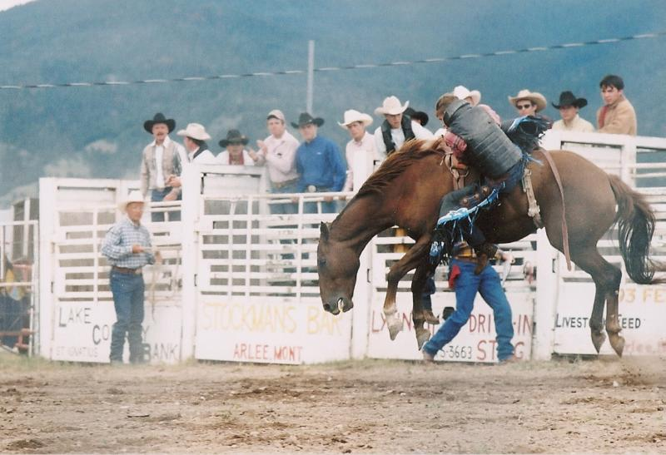
Slide 2 Plan for Session
Review some background on rural strategies for extending IL to un-served small towns and rural areas
Highlight the Concerns Report Method
Provide some real world examples from the perspective of a CIL director
Notes:
These tasks present a challenge as they are three – possibly four - distinct elements in which I am deeply interested. Moreover, I am driven to organize my work in a coherent fashion and these categories might represent a break in continuity – the research I’ve done in the past, my work in policy, a vision of the Institute in the future, and what I believe is the academic role of the Director. Then, I want to leave time for a discussion of issues that interest you- how you see the future. What ties all this together?
Provide an overview of rural America.
Review some background on rural community development.
Link community development to IL practice.
Briefly mention up to 15 rural outreach strategies.
Highlight the Concerns Report Method

Slide 3
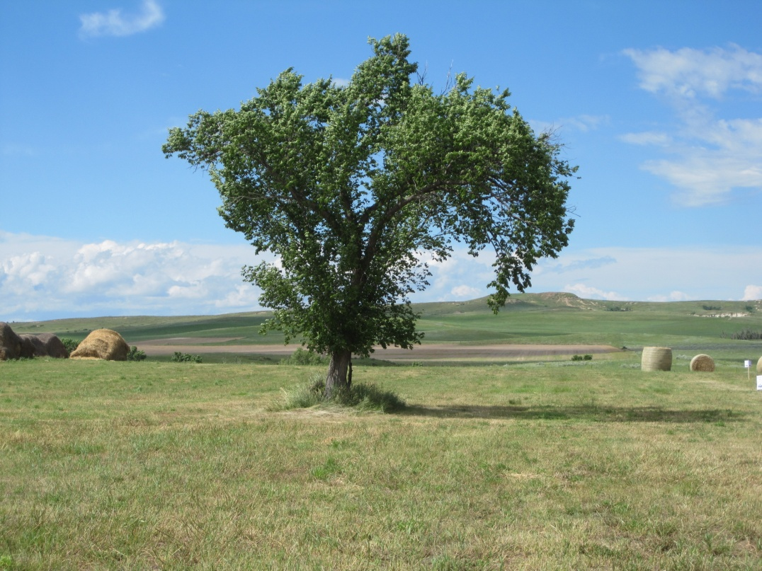
Slide 3 Independent Living
IL philosophy and the IL model are among the most significant developments in health and human services of the last 50 years.
But not everyone has had access to these developments.
Notes:
Changed the way we see ourselves.
Changed the way others see us
Changed the focus from blaming individuals to fixing the ENVIRONMENT
Created new laws that have transformed society and the communities in which we live
Been adopted by the WHO as a model for health
Emancipated thousands from institutions
Brought people together
For the residents of 1,800 (60%) of the nation’s counties, that dream has been a reality.
But residents of nearly 800 counties - mostly rural counties – lack even basic access to IL

Slide 4
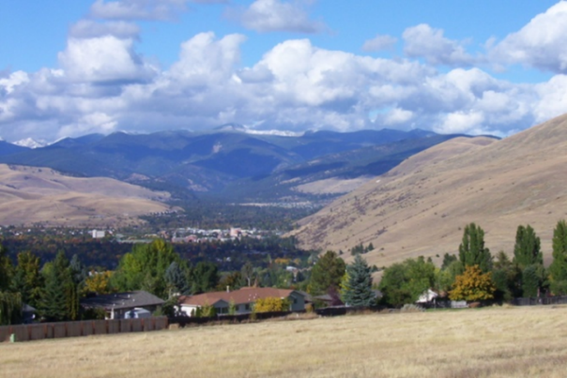
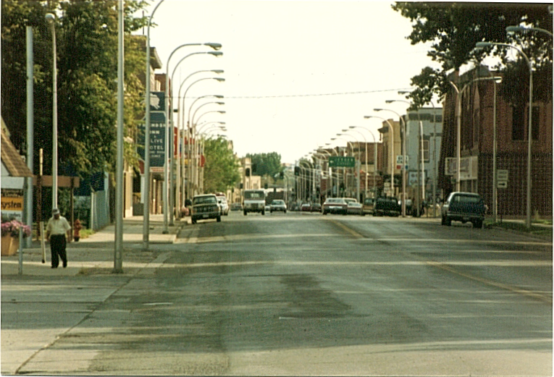
Slide 4 Rural America
There are 32,070 towns with populations of 10,000 or less
Equal to top 97 cities—about 57 million
2,049 rural counties
Residents of up to 40% of counties – most rural – are outside a CIL service area
Notes:
Smaller towns differ from each other.
I work with a team of extraordinary scientists and practitioners to transform discovery into applications that benefit rural Americans who experience disability.
Our laboratory is ..
You probably know someone who experiences disability or you may experience disability yourself.
If you do, you know that PWED face many barriers to health, education, employment, recreation, and simply participating in community life.
You have just heard three extraordinary presentations that addressed issues of disability brought on by neurological pathology, speech impairments, amputations, and other chronic health conditions.
BUT those conditions are not disability. Disability ONLY arises when the environment presents barriers to participation or fails to accommodate differences in individual function.
Disability then in an ECOLOGICAL event – and the ecologies in which disability occurs are the communities in which we live.
So, we practice CES and CBPR to create …

Slide 5
Slide 5 Some Basic Rural Dimensions
Potential Strengths
Potential Problems
Commitment to place
Socially tightly linked
Independent spirit of self-help and mutual aid
Socially tightly linked systems
Low population density
Distance and isolation
Thinner economic margins
Older Infrastructure
Fewer services
Inequity of resource allocations
Urban policy bias
Notes:
Socially tightly linked systems where a change in one can have multiple, unintended consequences for many others.

Slide 6
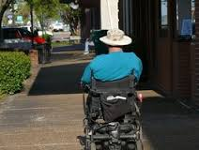
Slide 6 The Rural Vision
Vibrant small towns and rural communities— aided by CILS—in which all residents participate and enjoy a sense of belonging
How do you extend the IL model into un-served or underserved areas?

Slide 7
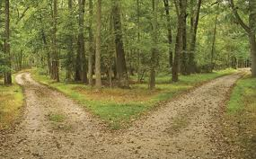
Slide 7 Many Pathways
Take as many as you need
Be sure that they fit the local values

Slide 8
Slide 8 OUTREACH Approaches
Mentored Satellite
Branch Office
Outreach Office
Out-stationing
Circuit Rider
Local Support Groups and Contacts
Surrogate Providers
Virtual CIL
Cooperatives
Community Education and Awareness
Community Development

Slide 9
Slide 9 Rural Independent Living is Community Development —A Strategy Using All Approaches
IL Emphasizes the Environment
Environment Means Community
Advocacy to Change the Environment Means Advocacy to Change the Community
There are many approaches and tools for community development.

Slide 10
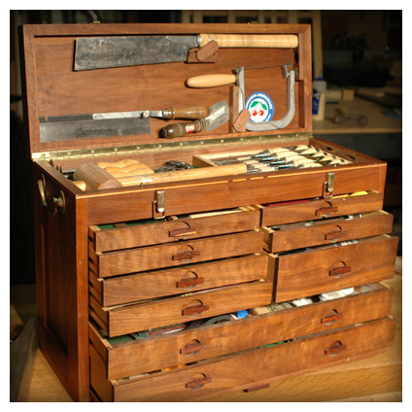
Slide 10 Tools People Use
RTC:Rural Creates Tools for Building Rural Communities
Notes:
Rural employment and economic development
Entrepreneurial approaches
Job creation
Working Well with a Disability
Rural health and disability
Management of chronic conditions
Prevention of re-hospitalization
Living Well with a Disability
Community development
Locality development
Citizen engagement
Rural Transportation

Slide 11
Slide 11 Rural Community Development and Independent Living
Rural Economic Development and Business creation
Rural transportation
Advocating for community accessibility with GRACE and CHARM
Rural Consumer Advocacy
Self Employment
Disability Counts
Living Well with a Disability health promotion

Slide 12
Slide 12 Questions and Answers

Slide 13
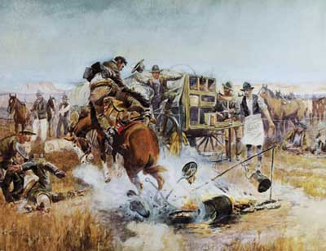
Slide 13 Definitions of Community
IL Emphasizes the Environment Environment Means Community Community is people who participate in activities in a shared place.
RTC:Rural Creates Tools for Building Community

Slide 14
Slide 14 Disability Concerns in Rural America
People with disabilities living in rural communities have many of the same concerns as their urban counterparts but experience them in distinct and different ways.
Example of transportation
Rural = No public transportation
Urban = Inconvenient schedules

Slide 15
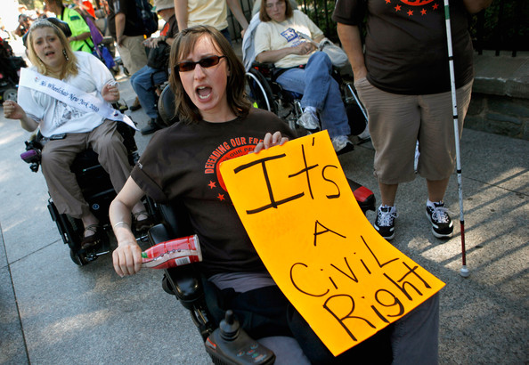
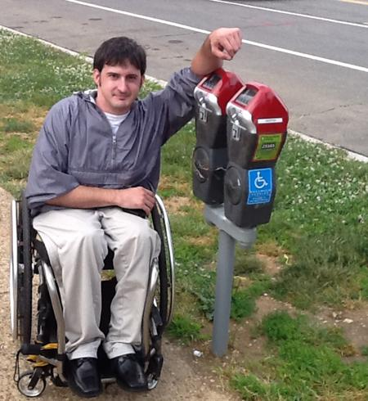
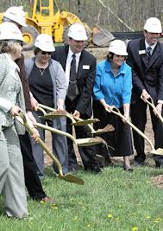
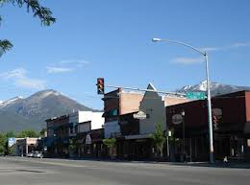
Slide 15 Rural Community Advocacy is Different
We are all in it together.
Notes:
In cities – advocacy means those with common interest working together to get others to do the right thing
In small towns and rural areas it means taking responsibility to get things done in the community of place

Slide 16
Slide 16 Rural America Context
Unlike Larger Cities, Formal and Informal Systems in Rural Communities are Tightly Linked
A change in one is likely to affect others
Members of rural communities take their time to consider the many implications of any change
Outsiders may see this as “backward”
The truth is that represents wisdom
Rural communities tend to be “small C conservative”—to protect their community
Notes:
Approach change more cautiously than urban
Thinner margins
More tightly linked
Changes more likely to affect multiple systems and individuals
Different solutions tend to emerge because
Experience, expectations, and resources differ
From urban standards
Across rural communities
Rural solutions more likely to apply to urban problems than urban solutions to rural problems

Slide 17
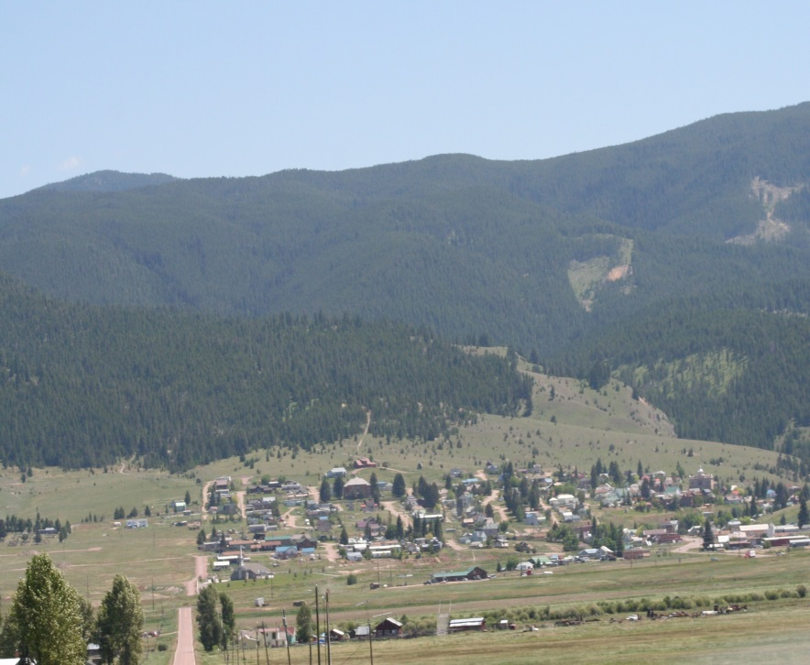
Slide 17 Community Development
Involves building partnerships to
Identify issues of importance around which you can organize
Create an agenda
Contribute to the community
Notes:
In this model, members of the community of interest negotiate the selection of issues to address and then seek resources to support the work
The Institution cultivates connections with “places” (communities, regions, or state systems). Faculty craft niches for researchers and students from different disciplines. Faculty engage community representatives to explore the potential contribution they might make – balancing the demands and expectations of their discipline with the interests of the community (or system). Together, they seek funding for specific projects. Over time, as the community, faculty, and disciplinary interests change, different actors are on stage while other retire to the wings. The breadth of topics
Mutually selected place(s) or systems
Commitment to long-term partnerships
Mutually selected topics and goals
Methods acceptable to the community
Jointly determined criteria for judging the significance of the outcome

Slide 18
Slide 18 1 QUESTION and 2 PRINCIPLES
QUESTION
What are some methods that might be used to expand the services if centers for independent living into currently underserved areas—especially rural areas?
PRINCIPLES
There are many paths to any goal.
Successful change has many parents.

Slide 19
Slide 19 Questions and Answers

Slide 20
Slide 20 Concerns Report Method (CRM)
CRM is an agenda building tool that involves local residents in assessing their environment and building an agenda for community improvement.
It has been used by Low Income and Wealthy Neighborhood Associations; Mental Health Advocates; Schools, and CILs around the world to organize and to achieve their goals.
Notes:
I develop tools to manage such situations. ‘
Science is the “machine tool” I use to make tools that solve real problems.
To develop evidence-based practices.
Obligated to see those tools used.
Design for use from the very beginning
understanding who will use them
how they will be used
the context of their use
who will pay for them.
Describe the Process
Give Some Examples
Suggest what it means to

Slide 21
Slide 21 CRM Flowchart
Evidence-Based Tools
Concerns Report Method
Un-served Community
Issue Agenda
Local Discussion Groups
Local Projects
Best Practices
Context | Assessment | Agenda Formation | Assessment, Planning & Commitment | Implementation and Monitoring & Feedback

Slide 22
Slide 22 Concerns Report Process
Local Steering Committee
Creates a Concerns Menu
Community Representatives Select, Edit, Create Items
Concerns Items are Organized in a Unique Survey Format
Concerns Survey is Widely Distributed to Involve As Many as Possible
Survey Responses Analyzed to Identify Strengths and Problems
Form and Agenda
Community Discussion Groups Create Commitment
Plan Derived from Discussions
Plan Widely Circulated and Presented to Build Awareness and Support
Projects Implemented
Achievements Noted and Momentum Builds for More

Slide 23
Slide 23 Sample Concerns Menu Items
The important places in your community are accessible.
Your community has enough accessible houses and apartments.
You can get where you need to go both in and out of town.
You have access to health-care provider knowledgeable about disability.
Employers treat you fairly.

Slide 24
Slide 24 Sample Survey Items
 | How Important is it to you that … | How satisfied are you that…
 | Not Very Important Important | Not Very Satisfied Satisfied
The important places in your community are accessible. | 0 1 2 3 | 0 1 2 3
Your community has enough accessible houses and apartments. | 0 1 2 3 | 0 1 2 3
You can get where you need to go both in and out of town. | 0 1 2 3 | 0 1 2 3

Slide 25
Slide 25 Sample Meeting Agenda
Potential Strengths |  |  | Potential Problems
 | Average Importance | Average Satisfaction |  | Average Importance | Average Satisfaction
Your community has accessible houses and apartments. | 89% | 82% | The important places in your community are accessible. | 92% | 62%
You have access to health-care provider knowledgeable about disability. | 89% | 81% | Employers treat you fairly. | 96% | 68%
 |  |  | You can get where you need to go. | 92% | 73%

Slide 26
Slide 26 Sample Report with Assignments
ISSUES – SOLUTIONS - RESPONSIBILITY
Your community is accessible. (98% - 68%) | Responsible Parties
 | County | City | Business | CIL | OTHER
Develop and implement a program for routine monitoring the public accessibility of the communities in the county. | X | X |  | X
Train and engage a consumer observer corps to conduct the monitoring. |  |  |  | X | X
Provide technical assistance to businesses and agencies on how to improve accessibility. |  |  |  | X
Create a regular Community Accessibility Report Card that is routinely “sent home.” | X | X
Create a community honor roll and award for achievement in accessibility for different categories of places (e.g., education, health care, retail business, etc.) |  |  | X |  | X

Slide 27
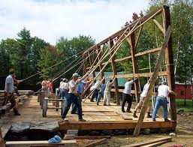
Slide 27 Establish IL in Un-served Rural Areas by Facilitating Working Together to Build Sustainable Community for Everyone

Slide 28
Slide 28 Questions and Answers

Slide 29
Slide 29 Summit Independent Living Center, Inc.
Concerns Reports Method for
Community Advocacy
& Rural CIL Branch Office Development

Slide 30
Slide 30 Background and Overview
Summit ILC serves 7 primarily rural counties in western Montana—19,616 square miles with a population of 304,508 (31% of MT total—2010 census)
Summit founded in 1981 in Missoula, Montana as a department of Community Medical Center
Standalone CIL since 1988
Service area grew from 1 county to 4 counties and then to current 7 county service area

Slide 31
Slide 31 Background and Overview, cont’d.
Summit awarded a grant through the Robert Wood Johnson Foundation “Improving Service Systems for People with Disabilities” program in 1991
RWJF grant—one-year planning grant & three-year implementation funding
Prior to RWJF provided services in Ravalli, Lake & Flathead Counties on an outreach basis—typically 1 trip/month
BOD commitment to expand services to rural counties
Utilized the Concerns Report Method as a key element in the establishment of 3 branch offices in 1992

Slide 32
Slide 32 Concerns Report Method Goals
CRM is a valuable tool to help CILs assess community needs and lay the groundwork for successful expansion of IL services and advocacy efforts
Develop local system change initiatives identified, prioritized and supported by residents of targeted communities
Develop buy-in and support for new branch offices to serve rural communities in our service area
Promote new/expanded IL services available through the branch offices

Slide 33
Slide 33 Concerns Report Method Goals, cont’d.
Overall focus on improving service systems & independent living options for people with disabilities
Ensure the process is consumer-driven and based on IL principles
Expand network of peer advocates, community partners and allied organizations in rural areas
Develop financial resources to support expanded services

Slide 34
Slide 34 Concerns Report Method—Survey Summary
Survey conducted in 1991
Missoula, Lake, Ravalli & Flathead Counties in western Montana
Two separate survey questionnaires were used to get perspectives of both consumers and service providers

Slide 35
Slide 35 Consumer Survey
258 of 1421 questionnaires mailed were returned (18% return rate)
Employment of respondents
Levels of health and independence
Relative strengths of communities
Relative problems/barriers encountered
Knowledge and current use of Summit services
Consumer interest in various services and participation in advocacy efforts to address problems

Slide 36
Slide 36 Provider Survey
84 of 250 service providers (34% return rate)
Disability populations served and types of service provided
Satisfaction with existing service system
Gaps in services
Interest in working collaboratively to address systemic problems
Interest in potentially purchasing services from Summit

Slide 37
Slide 37 Survey Results & Next Steps
Reports prepared by County for both consumer & service provider surveys
Overall summary report for all 4 counties—both consumer and service provider surveys
Town hall meetings held in communities throughout 4 county service area to discuss survey results and recruit participants for Planning and Action Committees to address identified problems

Slide 38
Slide 38 Planning and Action Committees
Set up a consumer-driven PAC in each of the 4 target counties
Members—consumers, advocates, service providers, local city and county officials, CIL staff, and peer advocates
Reviewed survey results and identified priorities for local system change initiatives
Met regularly to develop strategies to implement targeted community initiatives and collaborated with Summit and other agencies as coalitions were built
Helped determine best location for each of the 3 Summit branch offices
Helped recruit and interview candidates for a full-time county coordinator for each branch office
Helped steer, promote and support the branch offices the first few years of their operation

Slide 39
Slide 39 System Change Initiatives Addressed
Improve accessibility of public facilities
Strengthen enforcement of accessible parking laws
Expand outdoor recreation opportunities for people with disabilities
Develop additional transportation resources
Promote affordable and accessible housing
Improve hospital transition services
Others…

Slide 40
Slide 40 Outcomes
Significantly increased the number of consumers served in rural areas
3 branch offices still in operation today
Extensive education, training and technical assistance on ADA, including development of Title II self-evaluation and transition plans for several communities & many accessibility consultations
Improved access of state and federal outdoor recreation sites
State building code statute amended in 1997 to strengthen enforcement of exterior access requirements (parking, curb ramps, etc).

Slide 41
Slide 41 Outcomes, cont’d.
Transportation identified as a high priority by the Planning & Action Council in Ravalli County
PAC formed the first official Transportation Advisory Committee (TAC) recognized by the Montana Department of Transportation for purposes of rural transit program development in Ravalli County

Slide 42
Slide 42 Outcomes, cont’d. 2
Through the Transportation Advisory Council, Summit and the Ravalli County Council on Aging collaborated with other partner agencies to expand transit services for seniors and people with disabilities
Developed the Five-Year Transportation Development Plan required for receipt of 5311 funding for rural transit operations
Secured matching funds from the county through grassroots legislative advocacy
Wrote a proposal for 5311 funding that was awarded by the MT Department of Transportation and launched the "Bitterroot Bus" rural transit program in Ravalli County
Continued ongoing efforts over the years to improve funding and coordination of transit services in Ravalli County
Transportation Advisory Committee meets regularly each quarter 20+ years after founding by the original Summit Planning & Action Committee

Slide 43
Slide 43 Tips and Strategies
Tailor the Concerns Report survey to your CIL's unique goals, needs and service area
Build on existing contacts in targeted communities if available, particularly consumers and peer advocates
Don’t forget to include decision-makers and the movers and shakers in your community
Tackle problems/issues you have a reasonable chance of accomplishing

Slide 44
Slide 44 Tips and Strategies, cont’d.
Be prepared to follow through—the process is labor intensive and changes can take a long time to accomplish
Take into consideration the unique opportunities and challenges of each community—local buy-in is critical
Celebrate small victories along the way!
Keep your finger on the pulse in your service area as community needs change over time and your priorities may need to evolve (consider needs assessments periodically)

Slide 45
Slide 45 Questions and Answers

Slide 46
Slide 46 For More Information
Mike Mayer, Executive Director, Summit ILC
700 SW Higgins, Suite 101, Missoula, MT 59803
mmayer@summitilc.org
406-728-1630 (V/TT)
Tom Seekins, Director of Research at the Rural Institute
tom.seekins@mso.umt.edu
(406) 243-2654

Slide 47
Slide 47 Wrap Up and Evaluation
Please click the link below to complete your evaluation
of this program:
https://vovici.com/wsb.dll/s/12291g540d7

Slide 48
Slide 48 CIL-NET Attribution
Support for development of this training was provided by the U.S. Department of Education, Rehabilitation Services Administration under grant number H132B120001. No official endorsement of the Department of Education should be inferred. Permission is granted for duplication of any portion of this PowerPoint presentation, providing that the following credit is given to the project: Developed as part of the CIL-NET, a project of the IL-NET, an ILRU/NCIL/APRIL National Training and Technical Assistance Program.

