Slide 1
CIL-NET Presents…
Outcome Measures for CILs
A National Onsite Training
Pulling it all Together
September 13-15, 2011
Portland, OR
Presenters:
Mike Hendricks, Ph.D.
Bob Michaels
1

Slide 2
End of the Road!
Sources and Methods
Measurable Indicators
Collecting Outcome Information
Choosing Outcomes
to Measure
Storing Outcome Information
Using Outcome Information
Logic
Models
Analyzing Outcome Information
Outcomes
&
Outcomes Mgmt.

Slide 3
Question: How can we select good outcomes?

Slide 4
Essential Components of a Program, cont’d.
ACTIVITIES
OUTCOMES
INPUTS
OUTPUTS
Resources dedicated to or consumed by the program
What the program does with inputs to fulfill its mission
The volume of work accomplished by the program
Benefits or changes for participants during or after program activities
money
staff & staff time
volunteers & volunteer time
facilities
equipment & supplies
feeding and sheltering homeless families
providing job training
educating teachers about signs of child abuse
counseling pregnant women
number of classes taught
number of counseling sessions conducted
number of educational materials distributed
number of hours of service delivered
number of participants served
new knowledge
increased skills
changed attitudes or values
modified behavior
improved condition
altered status

Slide 5
Sources of Ideas for Outcomes
Program documents
Program staff
Volunteers
Program participants
Participants’ parents
Records of complaints
Programs or agencies that are “next steps” for your participants
Programs with missions, services, and participants similar to yours
Outside observers of your program in action

Slide 6
Writing an Outcome Statement
Target group + present tense verb + what want to happen:
Parents of preschool children use everyday moments to encourage early learning.
Adults completing the literacy program read at the 6th-grade level.
Home-bound seniors eat nutritionally balanced meals.
Battered women who wish not to return home meet self-defined objectives for rebuilding their lives.
High school boys reported for fighting demonstrate skills at resolving conflicts verbally.

Slide 7
Question: Can you go over the logic model again, and how indicators fit on it?

Slide 8
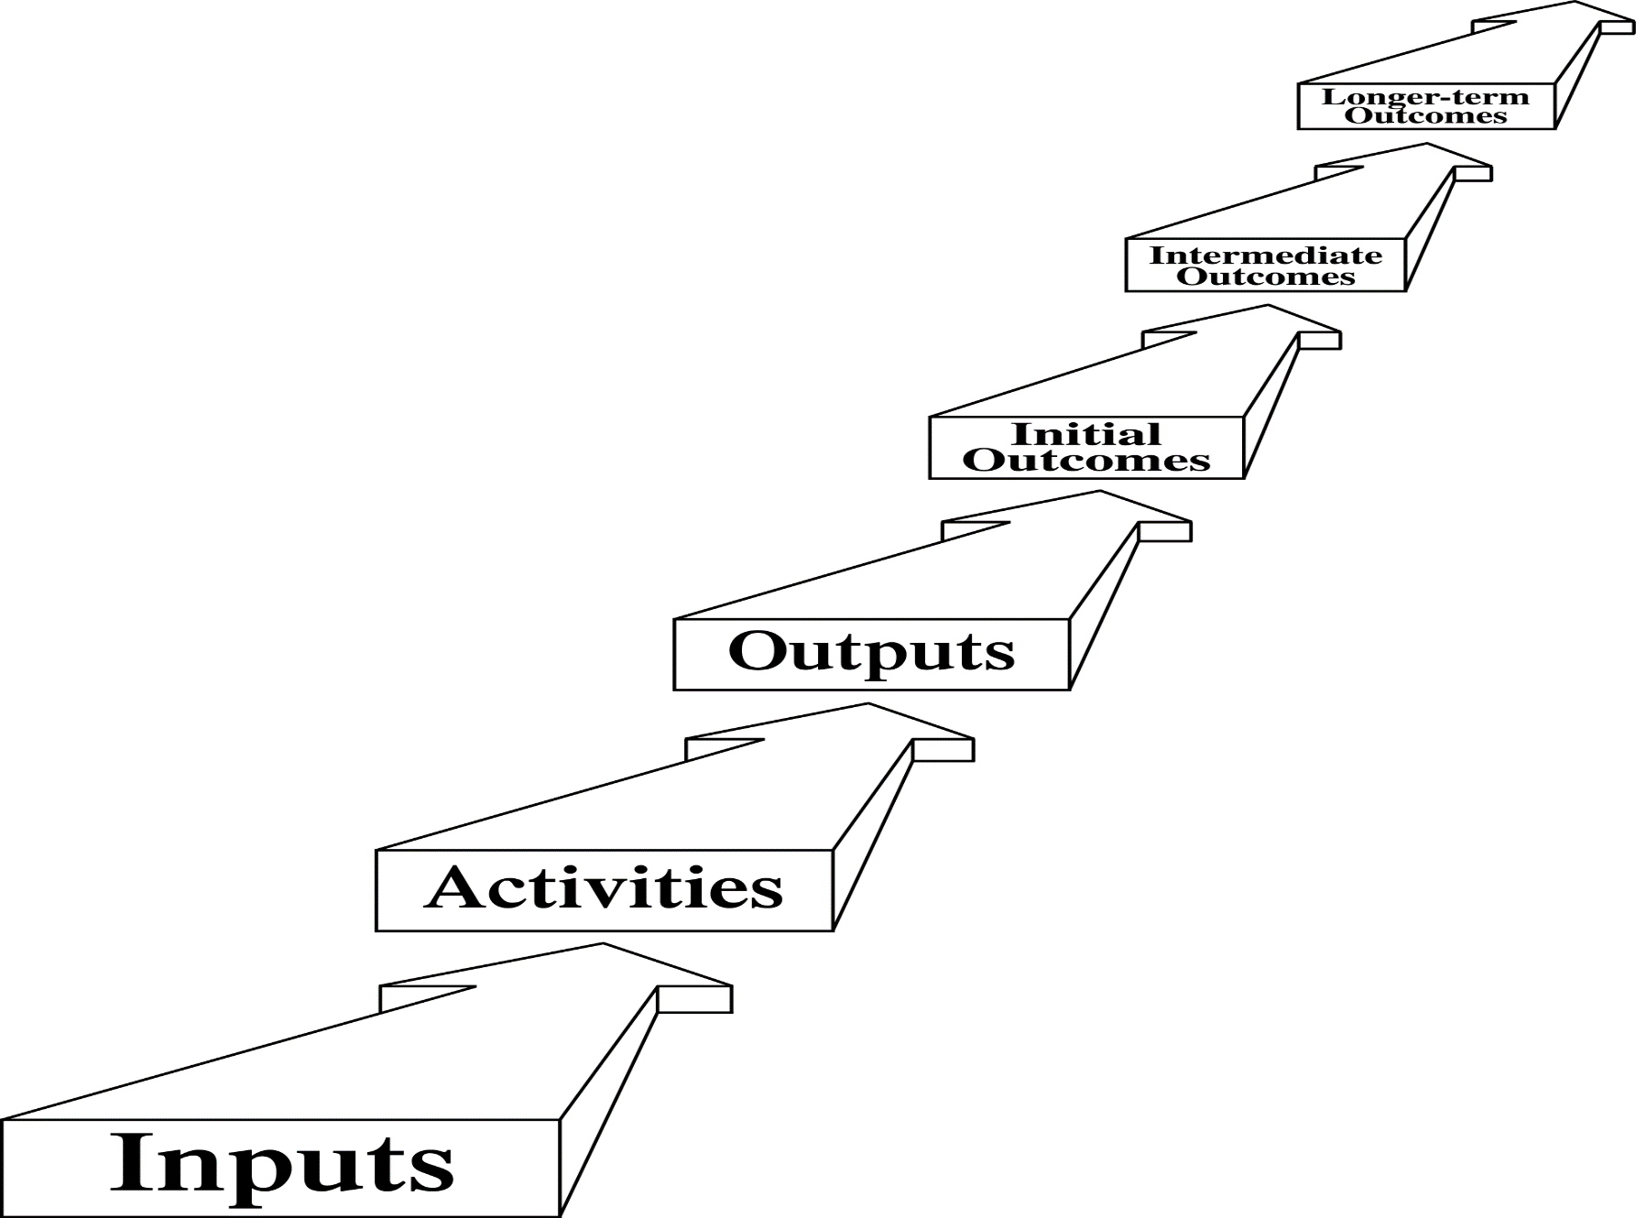
Inputs through Outcomes: The Conceptual Chain

Slide 10
IF → THEN Thinking
THEN . . . this outcome
THEN . . . this outcome – IF…
THEN . . . this outcome – IF…
IF . . . these activities

Slide 11
At-Risk Teen Mentoring Program
At-risk teens graduate from high school.
At-risk teens achieve
passing grades.
At-risk teens meet district attendance requirements.
At-risk teens
earn better grades.
At-risk teens attend school regularly.
At-risk teens complete homework regularly.
Mentors meet with at-risk teens for an hour each week. Mentors stress the importance of education, encourage school attendance, occasionally help with homework.

Slide 12
Proposed Logic Model for the CIL Program
PWD are integrated into American Society
PWD participate in communities to the extent they wish
Communities are more accessible – Housing, Transportation, Information, Employment, Education, AT, Health Care, etc.
Ultimate Outcomes
PWD regard themselves as more independent
PWD are more independent
Communities have more resources that support independence
Methods & practices promote independence
Intermediate Outcomes
v
PWD make their own choices
PWD advocate for increased community supports
Decision- makers act on our agenda
PWD have skills/ knowledge/resources to support their choices
PWD see different possibilities
PWD get the information they need
A consumer agenda for change exists
Active coalitions exist around our issues
Initial Outcomes
Barriers, problems identified
v
v
Activities
IL Services
Information and Referral
v
Systems Advocacy

Slide 13
Measurable Indicator
The specific item of information that tracks (“indicates”) a program’s success on an outcome:
Defines exactly what you mean by the outcome
Shows how much the outcome is being achieved
Often expressed as the number (#) and
percent (%) of participants achieving the outcome

Slide 14
At-Risk Teen Mentoring Program
At-risk teens graduate from high school.
# and % of teens who receive a diploma on time
At-risk teens achieve
passing grades.
# and % of teens who earn a C or better overall
At-risk teens meet
district attendance
requirements
# and % of teens who avoid attendance problems with the district
At-risk teens earn
better grades.
# and % of teens who earn better grades in the semester after the intervention than before
At-risk teens attend
school regularly.
# and % of teens who attend school at least 80% of the time
At-risk teens complete
homework regularly.
# and % of teens who finish their homework at least three days out of the week
Mentors meet with at-risk teens for an hour each week. Mentors stress the importance of education, encourage school attendance,
occasionally help with homework.

Slide 15
Question: Can indicators measure qualitative outcomes?

Slide 16
-- # and % of CIL consumers who feel more independent -- # and % of parents who appreciate what the CIL has done for their child -- # and % of City Council members who have a positive attitude towsards the CIL

Slide 17
Question: More examples of IL outcomes and indicators?

Slide 18
-- List of the field test outcomes and indicators in your materials -- Other examples we can think of together

Slide 19
Question: Instruments that are valid and reliable to measure CIL outcomes?

Slide 20
-- NCIL Task Force members -- Other experts in the IL field -- Literature -- ???

Slide 21
Question: More about the definition of “at risk”?

Slide 22
-- See page 11 of the Training Manual for the field test -- An important issue/gap for the IL field, in our opinion

Slide 23
Question: How do our outcome measures relate to the current 704 report and other federal requirements for information?

Slide 24
Question: What does the new Rehab Plan say about outcomes, our approach, etc.?

Slide 25
Other Questions?

Slide 26
For more information
Contact:
Mike Hendricks – MikeHendri@aol.com
Bob Michaels – bobmichaels@cox.net

Slide 27
CIL-NET Attribution
Support for development of this training was provided by the U.S. Department of Education, Rehabilitation Services Administration under grant number H132B070002-10. No official endorsement of the Department of Education should be inferred. Permission is granted for duplication of any portion of this PowerPoint presentation, providing that the following credit is given to the project: Developed as part of the CIL-NET, a project of the IL NET, an ILRU/NCIL/APRIL National Training and Technical Assistance Program.

