Slide 1
Independent Living Research Utilization

Slide 2
Get to the Core of It: Integrating CIL Core Services for a Holistic Consumer Experience Seamless Service Delivery Snapshots Presenters: Bruce Darling - Center for Disability Rights Darrel Christenson – Ability360 Michelle Crain – LIFE, Inc. Kimberly Tissot & Charlie Walters –Able SC May 1, 2018 Tempe, AZ

Slide 3
Seamless Service Delivery Snapshot Bruce Darling - Center for Disability Rights bdarling@cdrnys.org

Slide 4
Center for Disability Rights - Structure
Our services are provided by three separate non-profit organizations:
The Regional Center for Independent Living (founded in 1966, was funded as a CIL in the first round of grants).
The Center for Disability Rights (founded in 1990, began receiving CIL funding in 1999).
All About You Home Care (a subsidiary of CDR, started in 2008).

Slide 5
Service Area(s)
Regional Center for Independent Living serves Rochester (NY), Monroe County and 4 surrounding counties.
Center for Disability Rights provides IL services in Rochester (NY), but has multiple service areas for various services, including one division that serves the entire state.
All About You Homecare primarily serves Monroe County.

Slide 6
Services
Services include:
Core IL services, including peer support/mentoring
Managed Care Advocacy/Ombuds
Consumer Directed Personal Assistance Services
Licensed Home Care
Waiver In-Home Support Services (Developmental Disability, Brain Injury and alternative to NF)
Service Coordination
Employment Services
Pooled Trust Services

Slide 7
Services, cont’d.
Services include:
Recreation and Day Services
Accessibility audits and Home Modifications
Equipment Loans
Benefits Advisement
Housing Assistance, including assistance with first-time Home Ownership
Interpreter Services and Deaf-Blind Support Services

Slide 8
Systems Advocacy
Our Extensive System Advocacy includes Addressing Access Barriers and Other Local Issues with additional targeted resources for:
Policy Analysis and Advocacy in our State Capitol.
Advocacy against Assisted Suicide.
Lobbying for Disability Integration Act (DIA) in Washington, DC.

Slide 9
First Contacts
All incoming calls are answered by a receptionist, avoiding access problems/frustration with automated phone menus and ensuring people are appropriately served.
IL staff are scheduled to meet with and serve any "drop-in" consumer who comes to the office without an appointment or calls the CIL without identifying a specific staff person.
All IL staff are in rotation with half day shifts.
If the on-call staffer is busy with another consumer, they will follow up before the end of that shift.
Each staff person is then responsible for ensuring their contacts get the support that is needed.

Slide 10
Goal Development
IL staff work with consumers to develop their own goals for service delivery.
Both the staff person and consumer sign off on the goals, ensuring consumer engagement. We have also begun incorporating outcomes into goal statements.
Services provided by other funders may have their own system for documenting and tracking goals.
If an unmet need is identified, the consumer is connected with the staff person/department who can assist them in meeting their need.

Slide 11
Seamless Connections
All staff receive regular training on available services, with a specific effort to ensure that IL staff have the resources they need to connect consumers to internal and external resources.
Internal referrals among services (and between organizations) happen seamlessly.

Slide 12
Quality Assurance Follow Up
All consumers are contacted by Quality Assurance and asked about their experience.
Responses are documented in a survey.
If an issue remains unresolved or there is a problem, it is immediately handled.

Slide 13
Seamless Service Delivery Snapshot Darrel Christenson – Ability360 DarrelC@ability360.org

Slide 14
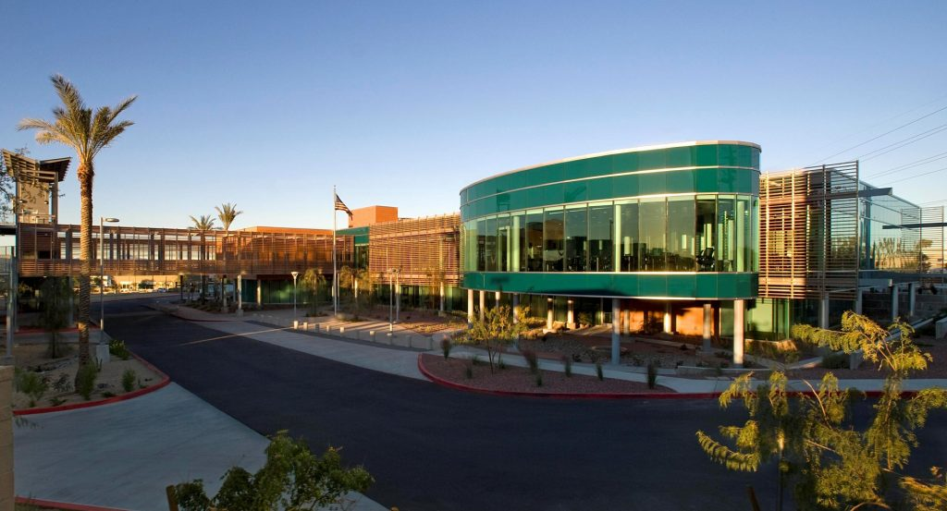
Ability360 Mission
Ability360 offers and promotes programs designed to empower people with disabilities to take personal responsibility so that they may achieve or continue independent lifestyles within the community.

Slide 15
Over 500 Centers for Independent Living ‒ 5 in Arizona
Designed and operated within a local community by individuals with disabilities
Provide an array of IL services
Not for profit

Slide 16
Independent Living Philosophy
We believe that the opportunity to fully participate in the political, economic and social life of our own community is a basic human right. The existence of a disability which inhibits personal function is not, in itself, a reason to deny those rights.

Slide 17
Ability360’s Reason for Existence
Help those who have a desire to live independently to do so, whatever it takes.
Work to help the consumer take responsibility for his or her own life and become self-directed
Offer options to assist in living independently via the many programs available through our organization

Slide 18
Ability360 Programs
Individual & Systems Advocacy
Independent Living Skills Instruction
Information & Referral
Peer Support
Transition
Reintegration from Nursing Homes
Early Intervention to People Newly Disabled

Slide 19
Ability360 Programs, cont’d.
Empowering Youth in Transition
Ability360 Employment Services
Work Incentives Planning and Assistance
Benefits 2 Work
Ability360 Sports & Fitness Center
Theatre360
Living Well with a Disability

Slide 20
Ability360 Programs, cont’d. 2
Home Care Services (HCS)
Socialization Through Recreation
Home Modification
This is My Life
Community Life Options
General Volunteers
ADA Services

Slide 21
Advocacy― Speaking Up for Self and Others
Systems, individual, and self-advocacy connect to all services and life issues.
Advocacy is an integral part of:
Individual & Systems Advocacy
Independent Living Skills Instruction
Information & Referral
Peer Support
Transition
Reintegration from Nursing Homes
Early Intervention to People Newly Disabled

Slide 22
Independent Living Skills
Bus/Travel
Meal Preparation
Budgeting
Goal Setting
Daily Living
Communication
Stress Management

Slide 23
Information and Referral
Knowledge is power
Community resources and locations
How to access resources and services such as:
Assistive Technology
Employment
Financial Assistance
Health Care
Housing
Transportation

Slide 24
Peer Support — Lifting as we climb!
Over 40 Peer Mentor Volunteers
Confidence / Knowledge / Experience

Slide 25
Employment Services
For SSI/SSDI beneficiaries who want to work their way off benefits
Focus is on ABILITY—not disability
REAL jobs with REAL wages

Slide 26
Early Intervention Outreach to Newly Disabled
Services at rehabilitation centers and hospitals
Guides newly disabled individuals through the maze of services and supports
Role models IL – HOPE!

Slide 27
Re-integration from Nursing Homes
Assists young adults (under age 65) in gaining the confidence, knowledge and resources needed to move out of nursing home settings.

Slide 28
Home Modifications
Increases self-reliance and safety!
Funding sources:
Community Development Block Grants
AHCCS/ALTCS
Private Pay

Slide 29
Empowering Youth in Transition
For youth with disabilities, ages 14-22
Provides:
Advocacy to students and parents
Technical support to special education teachers
Disability sensitivity training in schools
Technical assistance to regular education teachers in accommodating youth with disabilities

Slide 30
Community Living Options
Offers services for individuals with developmental disabilities who are ineligible for Federal and State support services.

Slide 31
Theatre360
A troupe of Valley-based artists dedicated to the personal, social and political voices of people with disabilities. Original theatre pieces born out of the life experiences and artistry of people with disabilities are presented. Periodic workshops for beginning and seasoned artists are offered.

Slide 32
Home Care Services
Trained caregivers provide assistance with daily living chores (housekeeping, dressing, bathing, meal preparation, etc.) for individuals eligible for Arizona Long Term Care Services (ALTCS).

Slide 33
Ability 360 Sports and Fitness Center Amenities
45,000-sq.-ft. facility
3 accessible pools
2 Sport courts
Indoor track
Group fitness room
Rock climbing wall

Slide 34
A Smattering of Sports & Fitness Programs…
Personal training
Military programs
Recreation therapy
Blind sports
Aquatic classes
Fitness classes
Wheelchair rugby
Wheelchair lacrosse
Performance training
http://ability360.org/sports/program-calendar/

Slide 35
Ability360 Locations
Pinal-Gila County Office
1419 N. Arizona Blvd.
Coolidge, AZ 85128
520.316.4300
Yavapai County Office
9400 E. Valley Road
Prescott Valley, AZ 85314
928-278-2450
Pima County Office
1001 N. Alvernon Way
Tucson, Arizona 85711
520.449.8375
Main Office
Ability360 Center
5025 E. Washington St.
Ste. 200
Phoenix, AZ 85034
602.256.2245
Gilbert/ Mesa Office
1580 N. Fiesta Blvd., #101
Gilbert, AZ 85233
480.655.9750
Glendale Office
6829 N. 57th Ave.
Glendale, AZ 85301
602.424.4100

Slide 36
Ability360 Sports & Fitness Center
5031 E. Washington St., Phoenix, AZ 85034
602.386.4566

Slide 37
Seamless Service Delivery Snapshot Michelle Crain – LIFE, Inc. michelle.crain@liferun.org

Slide 38
LIFE Inc.―Brief Overview
LIFE Inc. consists of two Centers for Independent Living (CILs)—the LIFE/RUN Center, in Lubbock and Disability Connections, in San Angelo.
Our service area is predominantly rural, with the majority of our consumer-base located within the same county as the CILs.
Roughly, 81% of our board, staff, and volunteers are individuals with disabilities.
Last year, we served 1,323 individuals with opened Consumer Service Records (CSRs) and provided 12,363 instances of Information & Referral (I&R).

Slide 39
Setting the Stage for Empowerment
It is our organizational structure, along with our commitment to the Independent Living Philosophy, that empower us to empower others.
We strongly believe that the CIL’s physical environment literally sets the stage for consumers to feel empowered to meet their goals. This includes:
Accessibility of our facility
Attitude of CIL staff
Prominent display of our Mission, Vision and Value Statements
Engagement of consumers in CIL activities

Slide 40
Setting the Stage for Empowerment, cont’d.
Inspirational messages on wall-hangings
People with disabilities engaged in meaningful work
I&R is the initial phase of LIFE’s holistic approach to providing seamless service delivery.
LIFE has two full-time I&R Specialists and as the initial contacts, must respond to callers with patience, objectivity, and a nonjudgmental attitude.
The I&R Specialists are the hubs of the CIL, obtaining information, assessing needs, and linking individuals to both community and internal services.

Slide 41
Setting the Stage for Empowerment, cont’d. 2
They perform and record follow-up calls to assure that consumers received services.
As host of the area’s Aging and Disability Resource Center (ADRC), LIFE’s San Angelo CIL retains a Resource Navigator who provides enhanced I&R by screening and linking consumers to long-term services and supports.
In evaluating the efficacy of our I&R services, we encourage, not only consumers to complete satisfaction surveys, but local resources who make referrals to LIFE.

Slide 42
Seamless Delivery of Services
LIFE has found that the Service Delivery Model, fundamental to most CILs, is very functional, and anytime we have strayed from this approach, it disrupts the process.
No matter the funding source, it has always been advantageous for us to streamline processes where possible.
Our goal is to provide wrap-around services and supports that are consumer-directed, have little wait time, meet consumers where they are and provide on-going support, if needed.

Slide 43
Seamless Delivery of Services, cont’d.
Cross-training is our way of empowering IL Staff to meet the needs of consumers. We are not a big organization, so staff may wear multiple hats. Therefore, all of LIFE’s direct-services staff are able to:
conduct intakes;
determine eligibility;
assist consumers with setting goals and identifying services;
assist with establishing an Independent Living Plan (ILP) with the consumer;

Slide 44
Seamless Delivery of Services, cont’d. 2
arrange, provide and/or purchase needed goods and services;
monitor progress of goals;
ensure appropriate training to consumers when necessary; and,
maintain all required components of the Consumer Service Record (CSR).
Each staff is effective in their own way at empowering consumers; but consistently applying basic motivational interviewing techniques during the process is currently a challenge.

Slide 45
Seamless Service Delivery Snapshot Kimberly Tissot & Charlie Walters – Able SC Ktissot@able-sc.org cwalters@able-sc.org

Slide 46
Who we are & what we do.
Mission Statement
To create greater access and opportunities for independence through
empowering individuals with disabilities and promoting community inclusion.

Slide 47
Making a difference everyday

Slide 48
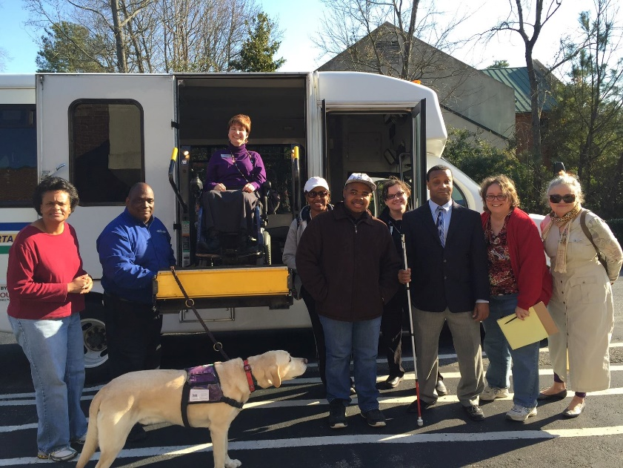
Able South Carolina is a Center for Independent Living
What is a Center for Independent Living?

Slide 49
Center for Independent Living (CIL)
Community-based
Consumer driven
Cross-disability
Nonprofit 501 (c)(3)
1978: Amendments to the Rehabilitation Act provide for consumer-controlled centers for independent living.
Notes:
What is a Core Service?
Centers for independent living provide services to individuals with a range of severe disabilities from cross-disability multicultural populations. The core services that centers for independent living provide are individual and systems advocacy, peer counseling, information and referral, and independent living skills training.
In addition to promoting and practicing the independent living philosophy, CILs are required to provide the following four core services: (1) Independent Living Skills Training teaches people with disabilities basic life skills toward becoming independent, or maintaining and enhancing independence. Examples include budgeting, self-advocacy, using public transportation, cooking, and stress management; (2) Advocacy Programs offer assistance in navigating through administrative networks to obtain services such as housing and health care. Advocacy programs also operate at the systems level to initiate, promote and protect public policy for the benefit of people with disabilities; (3) Peer Support Programs match people with disabilities who have similar circumstances and goals. A person who is adapting to life with a disability, transitioning to adulthood or to living more independently, may benefit from working with a peer who has experience and knowledge to share; and,
(4) Information & Referral Services are important because knowledge is power. Individuals may call when needing information on disability-related issues such as housing, employment, assistive technology, and legal issues. CILs maintain information on disability and community resources and refer callers appropriately.
Page 16
Roles and Responsibilities of CILs
In addition to promoting and practicing the independent living philosophy, CILs are required to provide the following four core services: (1) Independent Living Skills Training teaches people with disabilities basic life skills toward becoming independent, or maintaining and enhancing independence. Examples include budgeting, self-advocacy, using public transportation, cooking, and stress management; (2) Advocacy Programs offer assistance in navigating through administrative networks to obtain services such as housing and health care. Advocacy programs also operate at the systems level to initiate, promote and protect public policy for the benefit of people with disabilities; (3) Peer Support Programs match people with disabilities who have similar circumstances and goals. A person who is adapting to life with a disability, transitioning to adulthood or to living more independently, may benefit from working with a peer who has experience and knowledge to share; and,
(4) Information & Referral Services are important because knowledge is power. Individuals may call when needing information on disability-related issues such as housing, employment, assistive technology, and legal issues. CILs maintain information on disability and community resources and refer callers appropriately.

Slide 50
IL Philosophy
Independent Living philosophy emphasizes consumer control, the idea that people with disabilities are the best experts on their own needs. Their thoughts and opinions matter, especially when it concerns their own lives. They should be able to make decisions for themselves on how they live, work and take part in the community, particularly in reference to services that powerfully affect their day-to-day lives and access to independence.

Slide 51
Ed Roberts
Ed Roberts
Ed Roberts
Instead of saying, ‘We need to take care of them,’ say ‘We need to work with them so they can take care of themselves.’
-Ed Roberts
Father of the Disability Rights &
Independent Living Movement
“

Slide 52
Consumer Driven
Our Consumers decide what goals they want to achieve and what services they want to receive. Not only that, but they are responsible for the implementation and completion of their goals.

Slide 53
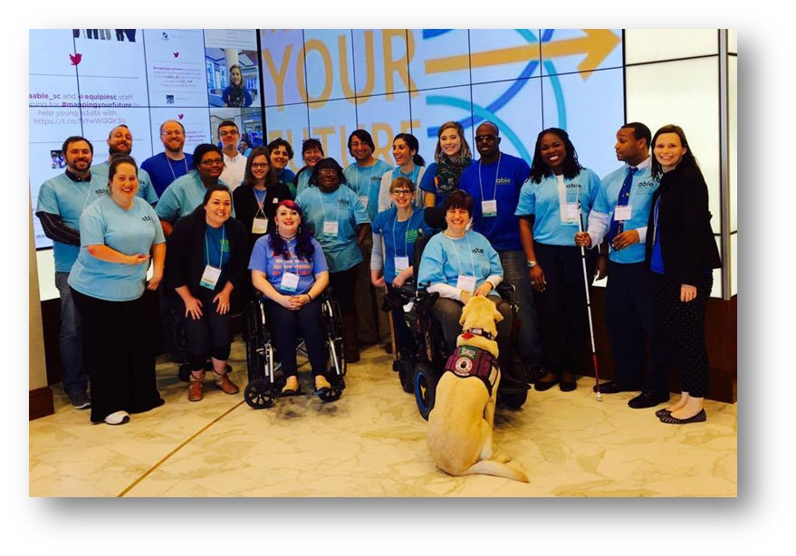
We Practice what we Preach
80% of our staff have a disability.
51%* of our board members have a disability.
*Federal law requires that a majority of board members be persons with a significant disability and a majority of staff members be persons with a disability.

Slide 54
We service 23 counties in the state
Abbeville
Anderson
Calhoun
Cherokee
Chester
Clarendon
Fairfield
Greenville
Greenwood
Kershaw
Laurens
Lee
Lexington
Newberry
Oconee
Orangeburg
Pickens
Richland
Saluda
Spartanburg
Saluda
Union
York
All our services are FREE!!!
and
there is no AGE REQUIREMENT
*Some of Able SC’s programs are statewide
*Some of Able SC’s programs are statewide

Slide 55
Services we Offer
Core Services
Information & Referral
Independent Living Skills
Peer Support
Advocacy
Transitional Services
Additional Services
Assistive Technology
Healthcare Navigation
Outreach
Professional Trainings
ADA Assessments
Website Accessibility Testing
Benefits Counseling
Supported Decision Making Counseling
Sexual/Domestic Violence Support
*Some of Able SC’s programs are statewide

Slide 56
Independent Living Skills
Communication skills
Budgeting
Employment skills
Resume writing
Interviewing
Career exploration
Professionalism
Household management
Organization
Emergency preparedness
Voting
Housing search
Home adaptation
Transportation options
Parenting with a disability
Goal-setting
Cooking
Self-advocacy
Education skills
Computer skills
Personal resource management
Healthy living
AND MORE!
*Some of Able SC’s programs are statewide

Slide 57
Peer Support
General Peer Support
Youth Peer Support
In Person meets the last Thursday of every month.
Online meets 2nd Thursday of every month.
Topics of discussion focus around independent living. The only requirement for participation is that a person must have a disability.
In Person meets the 3rd Thursday of every month.
Online meets 1st Thursday of every month.
Topics of discussion focus around transitioning into adulthood, self-advocacy, and independent living skills.

Slide 58
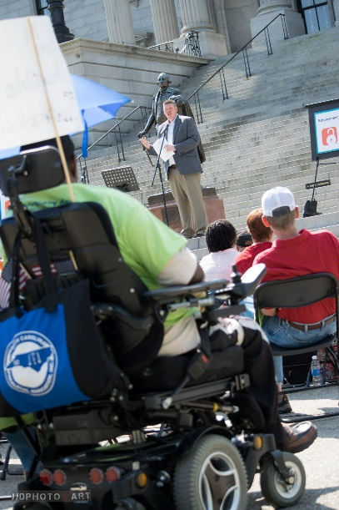
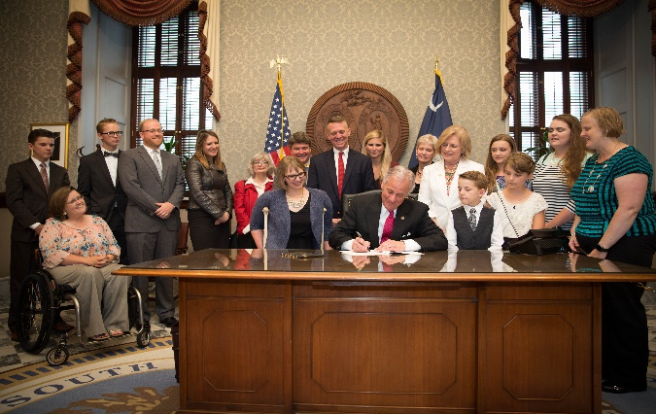
Advocacy
We’re at the forefront of activism and leadership on any and all issues affecting people with disabilities – issues like accessibility, public accommodations and transportation. These are critical in achieving full inclusion in community life. We work with local, state and national leaders to bring about change and create opportunities.
The USC School of Public Health has funded an effort to increase participation of individuals with disabilities on boards, committees, and councils. The course teaches skills such as professional dress, ethic and legal responsibilities, and Robert’s Rules of Order.

Slide 59
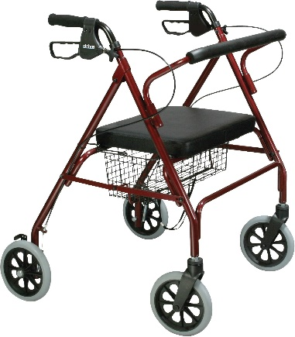
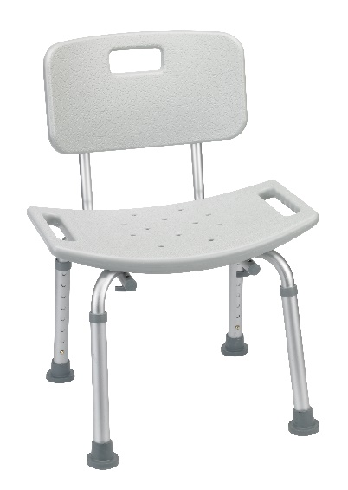
Assistive Technology
Grab bars
Rollators
Canes
Wheelchairs
Shower Chairs
Reachers
Big button items
And much more…
Assistive technology is provided free of charge. All items are donated to Able SC. We clean and sterilize the item, then provide it to individuals in need.

Slide 60
Youth Services
EQUIP teaches young adults about leadership, disability pride, and empowerment – and educates the community about the importance and value of inclusion. Age range is 13-28.
A unique 3 day overnight summer leadership experience that empowers and enhances the leadership and self-advocacy skills for young adults with disabilities.
*Able SC’s Youth Programs are funded by the SC Developmental Disabilities Council, United Ways of Greenville and the Piedmont, SC Department of Education, SC Commission for the Blind, the Statewide Independent Living Council and a subcontract with Family Connection of SC.

Slide 61
Youth Services — School Grants
Capable & Ready (careerBOOST™):
Pre-Employment Transition Services
SC DOE:
Statewide
Project Inclusion: Cherokee
Path to Achieving Self-Sufficiency (PASS):
Greenville
Parent Training & Information (PTI):
Supplements one-on-one and group youth services

Slide 62
Health-Related Services
Able South Carolina offers group instruction on healthy lifestyles through our Steps to Your Health classes at different sites in the community.
We also have certified Healthcare Navigators who can provide individuals with disabilities and their family members with assistance in finding appropriate and affordable medical insurance!

Slide 63
Employment Programs
Ticket to Work
Able SC is approved by the U.S Social Security Administration (SSA) to serve Ticket Beneficiaries as an Employment Network (EN) under SSA’s Ticket to Work program. We provide individualized employment services to individuals who wish to increase their financial independence and decrease reliance on government benefits.
Work Incentives Planning and Assistance (WIPA)
Individuals ages 14 to full retirement age who receive or are entitled to SSA benefits and are working or seeking employment can receive one-on-one counseling about how working will impact their benefits. They will learn about work incentives, discover how to report income, and get connected to beneficial resources in the community. We subcontract with our Center organization, Walton Options for Independent Living.

Slide 64
Employment Programs, cont’d.
South Carolina Disability Employment Coalition
South Carolina Employment First Initiative
The Coalition addresses employment barriers for individuals with disabilities in South Carolina through collaboration on resource development and community education. Able SC serves as the host and facilitator for the Coalition, which consists of around 30 employers, state, and private organizations.
An effort by state agencies and employment service providers to implement systemic change in order to promote competitive, integrated employment as the preferred option for young adults with disabilities. The Initiative’s efforts include the #HireMeSC social media campaign and a pilot program in schools to improve student access to employment opportunities.
*These efforts are funded by the SC DD Council and the US Department of Health and Human Services' Administration for Community Living

Slide 65
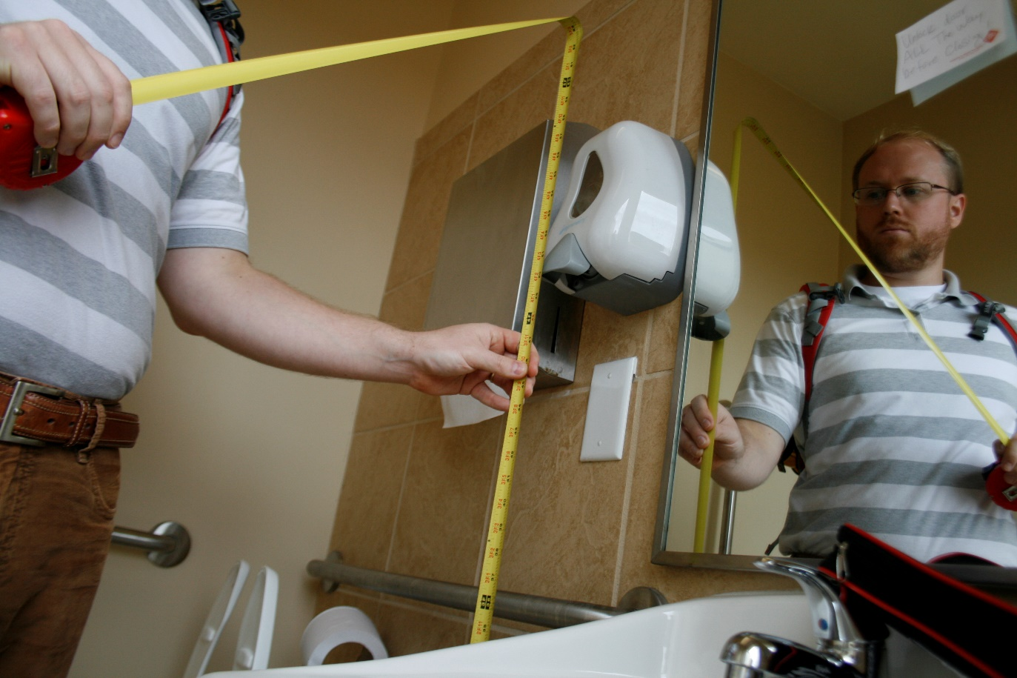
Accessibility Assessments
A few of our clients
City of Greenville
City of Greer
City of Columbia/Parks
SC DHHS
SC DHEC
SC DSS
Richland County Parks
Consultation, site review, and recommendations for removing physical barriers from public and private building in order to meet Americans with Disabilities Act (ADA) structural guidelines.
38

Slide 66
1/5 South Carolinians has a disability
39

Slide 67
The Father of Independent Living
The Father of the Independent Living Movement
As we get older, we realize that disability is just a part of life. Anyone can join our group at any point in life. In this way the disabilities rights movement doesn’t discriminate.
-Ed Roberts
Father of Independent Living Movement
“

Slide 68
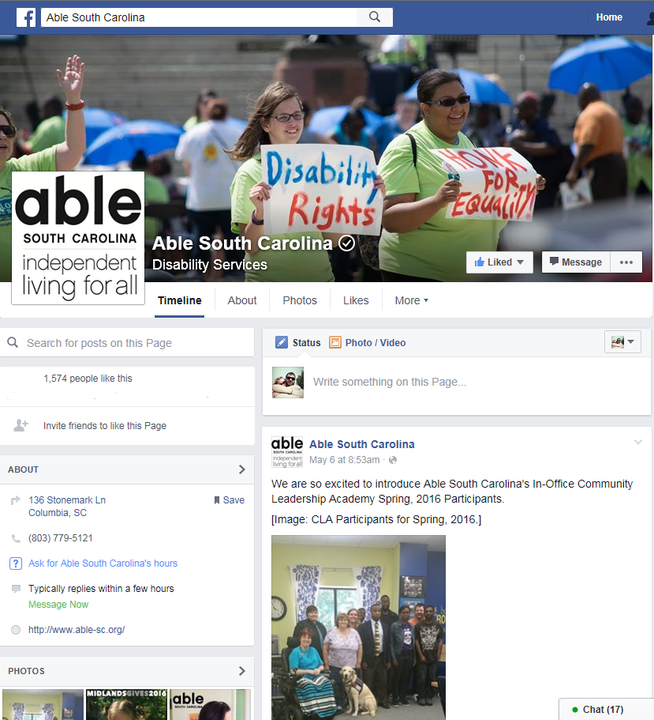
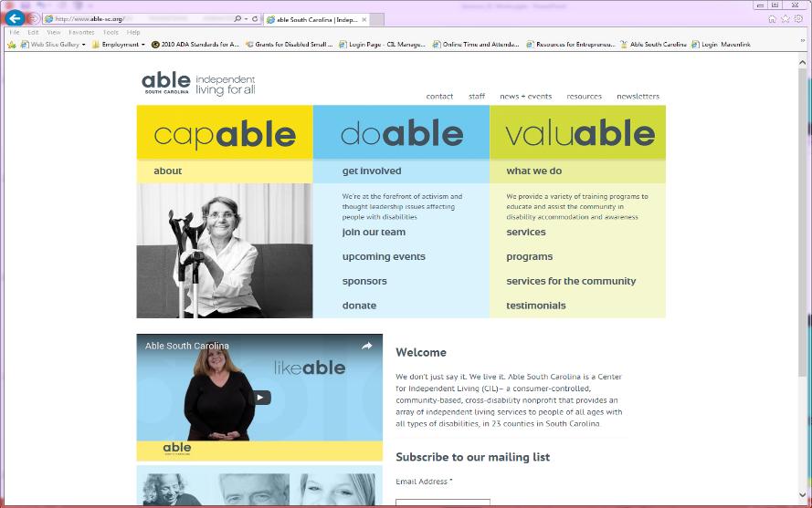
Find Us Online
www.able-sc.org
Find us online at…
www.able-sc.org

Slide 69
Thanks!! Any Questions?
You can find me at…
Kimberly Tissot
803.779.5121 ext. 224
ktissot@able-sc.org

Slide 70
CIL-NET Attribution
Support for development of this technical assistance information was provided by the Department of Health and Human Services, Administration for Community Living under grant number 90ILTA0001. No official endorsement of the Department of Health and Human Services should be inferred. Permission is granted for duplication of any portion of this information, providing that the following credit is given to the project: Developed as part of the CIL-NET, a project of the IL-NET, an ILRU/NCIL/APRIL/USU-CPD National Training and Technical Assistance Program.

