Slide 1
>>Slide 1 OILP Grantee Quarterly Connection Friday, December 18, 2020 2:00pm-3:00pm EST
Update from the Director (Corinna Stiles, 10 min.)
Technical assistance: Using your PPRs to increase agency effectiveness. (Sean Barrett, Paula McElwee 10 min.)
ACL Partnerships: National Paralysis Resource Center run by the Christopher and Dana Reeve Foundation (Elizabeth Leef, Mark 10 min.)
COVID and the winter – How are CILs addressing the need? (10 min.)
Q and A

Slide 2
>>Slide 1 ILRU’s IL-NET National Training and Technical Assistance Center for Independent Living
ILRU’s IL-NET National Training and Technical Assistance Center for Independent Living

Slide 3
>> Slide 3 Internal uses: Program Performance Report
Some Executive Directors provide the entire report to the staff and board of directors. Others provide full report to executive committee only.
Some Executive Directors summarize information from the PPR and provide the summary to the staff and/or board of directors.
Highlighting specific information may be useful for identifying the unserved or underserved for future planning purposes.
The report may also be useful for developing/updating your work plan.
The raw data used to develop the report may also be useful in measuring and evaluating employee performance.

Slide 4
>> Slide 4 External uses: Program Performance Report
Some states use the information in a combined, statewide report to its stakeholders. This is often done in conjunction with the SILC or the state’s association of centers.
Individual centers prepare a summary for their “day at the capitol” or other meetings or hearings with legislators or committees.

Slide 5
National Paralysis Resource Center and Centers for Independent Living
OILP Grantee Quarterly Connection
Friday, December 18, 2020
2:00pm-3:00pm EST
ChristopherReeve.org
@ReeveFoundation

Slide 6
Once you
choose hope,
anything’s
possible.”
— CHRISTOPHER REEVE
National Paralysis Resource Center
With partnership from the Administration for Community Living, the Paralysis Resource Center (PRC) provides much-needed free educational information, programs, emotional support and individualized assistance to Americans living with paralysis, along with their caregivers, families and medical professionals.
00/ 00/ 00
*Cooperative Agreement Grant Number: 90PRRC0002-03-002

Slide 7
Snapshot of Impact
Information Specialists
100,000+ families have received one-on-one assistance in 170 language
Quality of Life Grants
$30 million+ awarded to over 3,100 non-profit programs in all 50 states
Reeve Connect
7000+ users on the private forum where individuals ask questions and share
Paralysis Resource Guide 210,000 copies distributed of the Reeve Foundation’s community
1st call made when loved one is diagnosed with paralysis
Virtual Community
3M+ users visit ChristopherReeve.org and social media channels annually
Health-Related Materials
300+ publications on how to live a healthy and independent life
Military and Veterans Program
Supports the unique needs of service men and women regardless of when they served or how they were injured
Peer & Family Support Program
14,000+ people have received support from 400+ certified peer mentors who are also living with paralysis

Slide 8
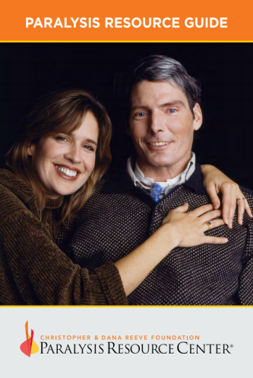
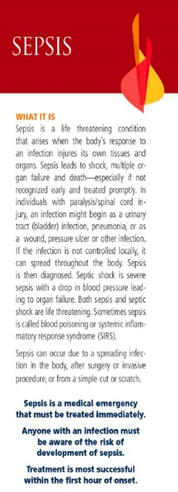
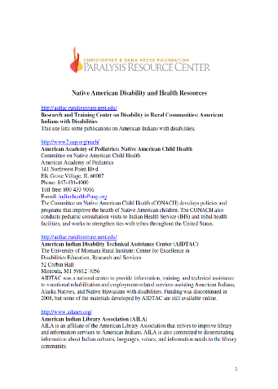
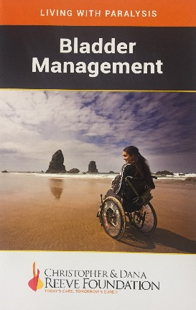
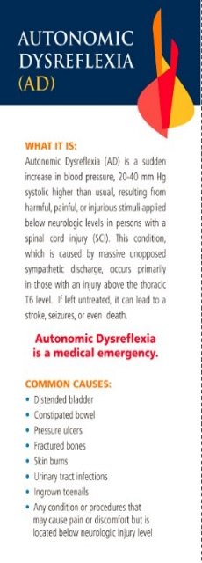
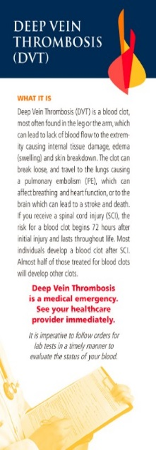
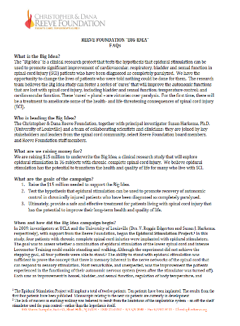
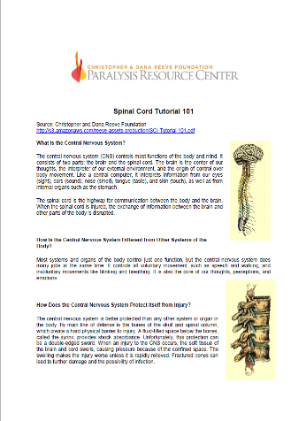
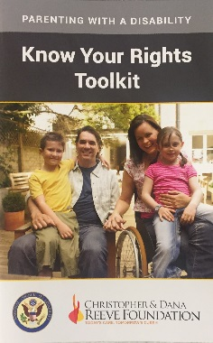
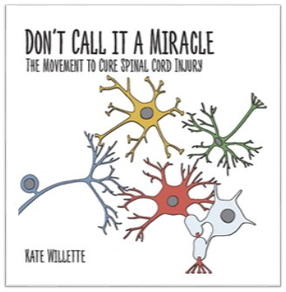
Free Materials & Resources
Books
Wallet Cards
Fact Sheets
Publications
PAGE 8

Slide 9
NPRC awarded 210 grants to CILs and 9 to Associations of CILs totaling $2.7 million
5 awards to State Independent Living Councils totaling $32,500
ACL awarded two targeted state initiatives:
Texas State Independent Living Council - Virtual Independent Living Services in Underserved Areas
Ohio State Independent Living Council – Disaster Preparedness
NPRC,
ACL,
and the CILS

Slide 10
Quality of Life Grants Program
The Quality of Life Grants Program impacts and empowers people living with paralysis, their families and caregivers by providing grants to nonprofit organizations whose projects and initiatives foster inclusion, involvement and community engagement, while promoting health and wellness for those affected by paralysis in all 50 states and U.S. territories.
Notes:
Read above.

Slide 11
Eligibility
Quality of Life grant applications are accepted from 501(c)(3) nonprofit organizations, municipal and state governments, school districts, recognized tribal entities, and other institutions such as community or veterans hospitals.

Slide 12
2020-2021 Tiered Grants Structure
Direct Effect (Tier 1)
Open Focus; Up $25,000
High Impact Priority (Tiers 2, 3, & 4)
Focus on specific high priority issues for individuals living with paralysis
Tier 2 – 10 grants of $30,000 for the following Priority Areas:
Transportation
Respite/Caregiving
Disaster Response
Tier 3 – 4 Grants of $40,000 for Nursing Home Transition
Tier 4 – 5 Grants of $50,000 for Employment
Expanded Effect (Tier 5)
Up to $100,000 for previously awarded QOL grantees whose programs and/or projects have achieved demonstrable, successful impact.

Slide 13
Direct Effect – Examples of Funded Projects
Accessibility Modifications
Adaptive Sports
Accessible Playground/Ball Field
Accessible Trail/Tree House/Beach
Assistive Technology
Advocacy
Arts
Camp
Caregiving
Consumer Education
Durable Medical Equipment (see
funding restrictions)
Education
Employment
Facility Accessibility Modifications
Fitness and Wellness
Healthcare
Media Development
Medical Professional Education
Peer Mentoring and Support
Service Animal Program
Therapeutic Horseback Riding
Transportation
Transition from Institution to Home

Slide 14
Types of Direct Effect (Tier 1) Projects Funded
sports wheelchairs for a wheelchair basketball team
adapted glider in a community playground
kayak for a rowing program
accessible gym equipment
hydraulic lift at a pool
electronic door openers at a community center
Workshop education series on sex and sexuality with a spinal cord injury
wheelchair accessible picnic table at a county fairground
Program for preventing abuse in adaptive sports
camp programs
subsidized lessons for therapeutic riding
transportation costs for an inclusive afterschool program
support groups

Slide 15
High Impact Priority – Descriptions of Tiers
Tier 2 (up to $30,000)
Transportation
Grant funds support nonprofit organizations and programs that provide accessible transportation to people living with paralysis to access services in their communities. In addition, funds may support adaptive driving education programs to enable people to learn how to drive and increase their independence and transportation options.
Respite/Caregiving
This grant area recognizes family caregivers and the vital role they play in caring for those with paralysis. Funds support nonprofits that offer exemplary and innovative respite care services that are evidence-based, appear promising, or are trying new service models.
Disaster Preparedness
Grant funds support nonprofit organizations and programs that address the emergency preparedness needs of people with paralysis in a natural disaster environment.

Slide 16
High Impact Priority – Descriptions of Tiers
Tier 3 Nursing Home Transition (up to $40,000)
Funds support Centers for Independent Living (CILs) and other organizations that provide transition services across the country to transition people with paralysis living in nursing homes back into their homes or a community-based setting of their choice. Funding also supports diversion.

Slide 17
High Impact Priority – Descriptions of Tiers
Tier 4 Employment (up to $50,000)
Grant funds support programs and projects that:
Assist individuals living with paralysis to enter, re-enter, remain, and advance in the workplace;
Create career pathways to meaningful, living wage jobs; and
Provide job development services to people living with paralysis, including career education, adaptive technology and career training with the goal of finding gainful employment.

Slide 18
COVID-19 and Winter
Reeve Foundation
Nurse Linda Webinar providing accurate, accurate, timely and specific information about the vaccine for individuals with paralysis/disabilities.
FAQ
Ongoing “IS” calls
Concern in upticks
Fear of caregivers coming into homes

Slide 19
COVID-19 and Winter
QOL Grantees
Expand on wellness and telehealth experiences virtually
Increased online services: accessible physical activity opportunities, mental health support, and social connection.
virtual social gatherings and activities, cooking and nutrition classes/demonstrations, music therapy, book clubs, movie nights or discussion groups for individuals and families, exercise classes, virtual counseling sessions for individuals and families conducted by licensed clinical social workers and counselors, mindfulness programming
Building community partnerships
collaborate with a local library for the lending of video gaming controllers, virtual museum visits

Slide 20
Reeve Summit 2021: Where Care, Cure and Community Connect
Virtual Conference April 27-29, 2021
Convene and galvanize the paralysis community as we mark a new era in our shared mission of improving the quality of life for all people living with or impacted by paralysis and related disabilities.
Open call for proposals for educational sessions that are informative for the entire paralysis community, including caregivers and health care professionals.

Slide 21
Thank You
Mark A. Bogosian
Director, Quality of Life Grants Program
(973) 232-0577
mbogosian@ChristopherReeve.org
www.ChristopherReeve.org

Slide 22
>>Slide 1 OILP Grantee Quarterly Connection Friday, December 18, 2020 2:00pm-3:00pm EST
Update from the Director (Corinna Stiles, 10 min.)
Technical assistance: Using your PPRs to increase agency effectiveness. (Sean Barrett, Paula McElwee 10 min.)
ACL Partnerships: National Paralysis Resource Center run by the Christopher and Dana Reeve Foundation (Elizabeth Leef, Mark 10 min.)
COVID and the winter – How are CILs addressing the need? (10 min.)
Q and A

